Slide 1
Staying Connected!
Kari Evans, DTM
Public Relations Manager

Slide 2




Free Virtual Meeting Platforms
Zoom (http://zoom.us/) – 40 minutes limit on Free account – 100 members limit
Skype (https://www.skype.com/en/) – 50 members limit
Webex (https://www.webex.com/) – 45 days free
Google Duo (https://duo.google.com/about/) – 8 people limit
Any other online meeting platform provided by your corporation

Slide 3
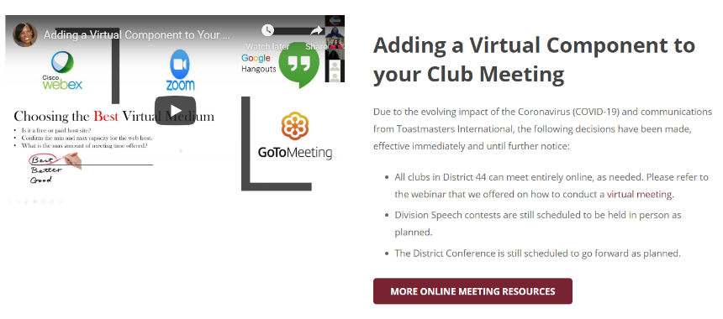
Online Meeting Resources – District 44 Website

Slide 4



Staying Connected with Members and Guests
Communication
Phone/Text
Email – individual or newsletter
Apps (What’s App, Group Me, Slack)
Club Website
Videos
Member created videos
Toastmasters Club Experience
Articles
Harvard Business Review
Toastmasters International Social Media Pages
Webinars
Create or repost webinars

