Slide 1
Pathways
Base Camp Manager Training
Created By: Pathways Champions
Created Date: 12/29/20
Last Modified Date: 01/12/21

Slide 2
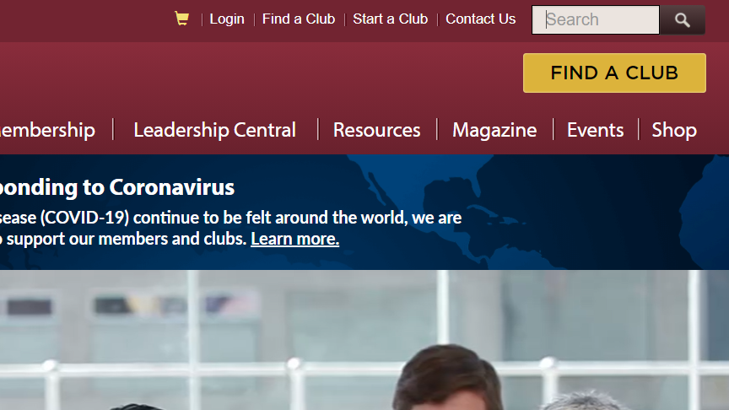
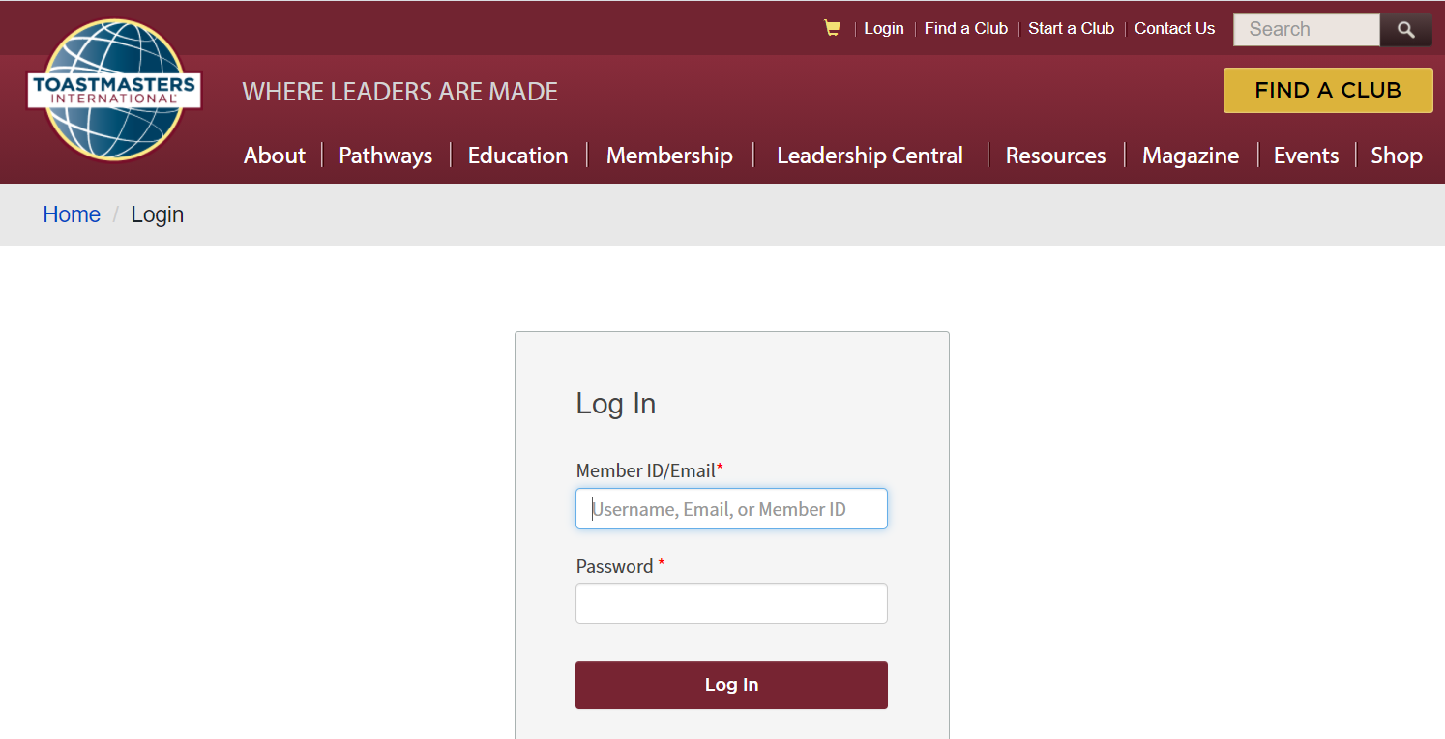
Login to Toastmasters
1
Navigate to the Toastmasters.org site.
Click “Login” on the top menu.
2
3
Enter your member ID or email address, along with
your password.
Click the “Log In” button.
4

Slide 3
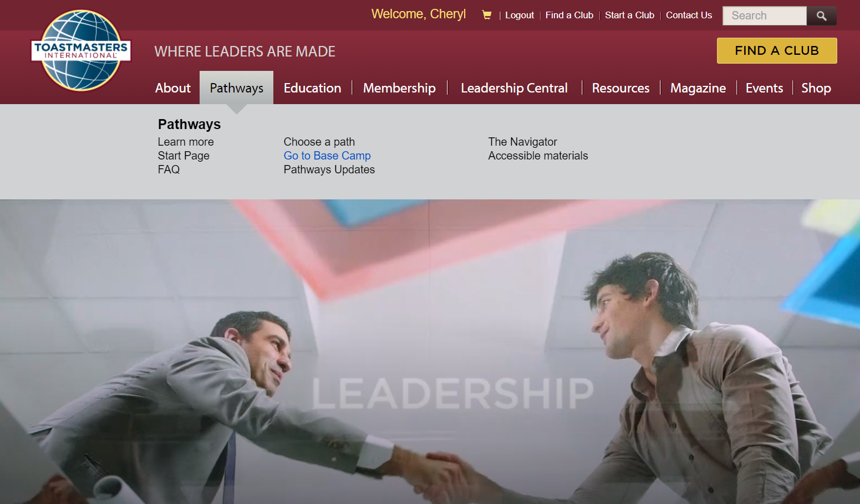
Navigate to the Pathways Start Page
1
2

Slide 4
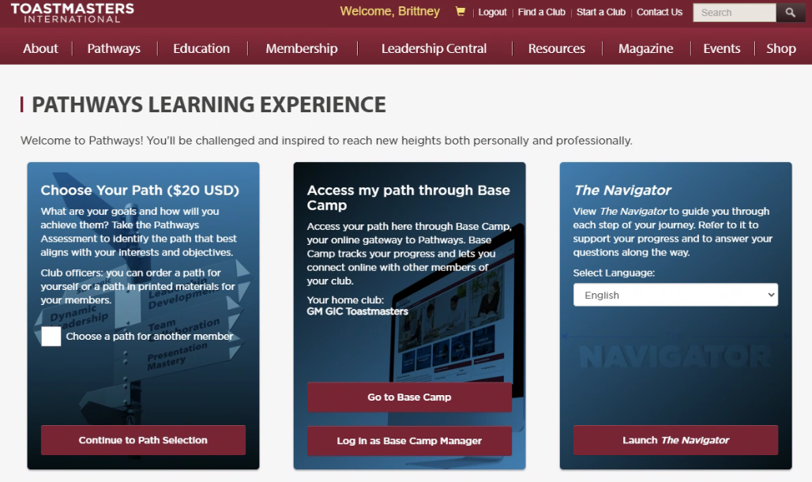
Log In as Base Camp Manager
Notes:
1. If one belongs to multiple clubs, he/she must also select the club they want to access before clicking the “Log in as Base Camp Manager” button. If he/she belongs to only 1 club, that club will be selected by default as displayed in the screenshot.

Slide 5
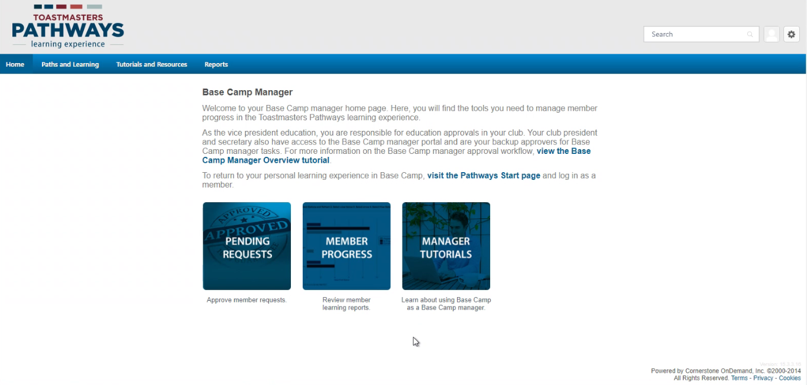
View Base Camp Manager’s Home Page

Slide 6
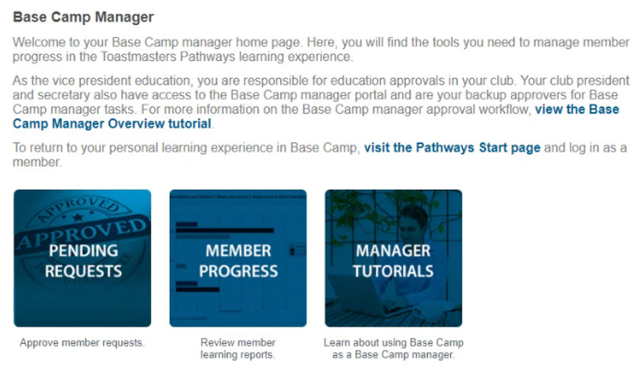
Access Pending Requests

Slide 7
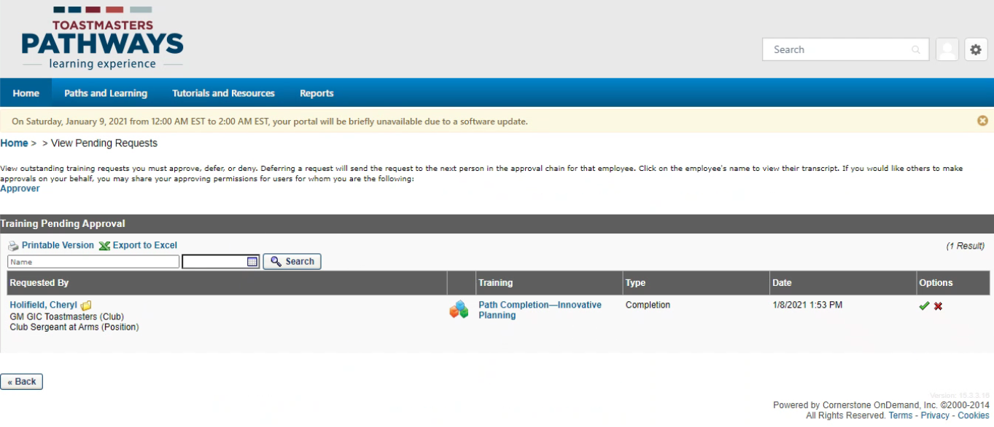
View the Pending Requests
Notes:
One should see a listing of requests in which they can approve or deny.
Requests are sent to the club’s email address. Once can check Club Central to see which address is listed.
Base Camp Managers receive an email once a request has been submitted.

Slide 8
Approve/Deny Requests
If requests are pending, the Base Camp Manager user can click the checkmark icon at the end of a request to accept it or click the x icon to deny it.

Slide 9
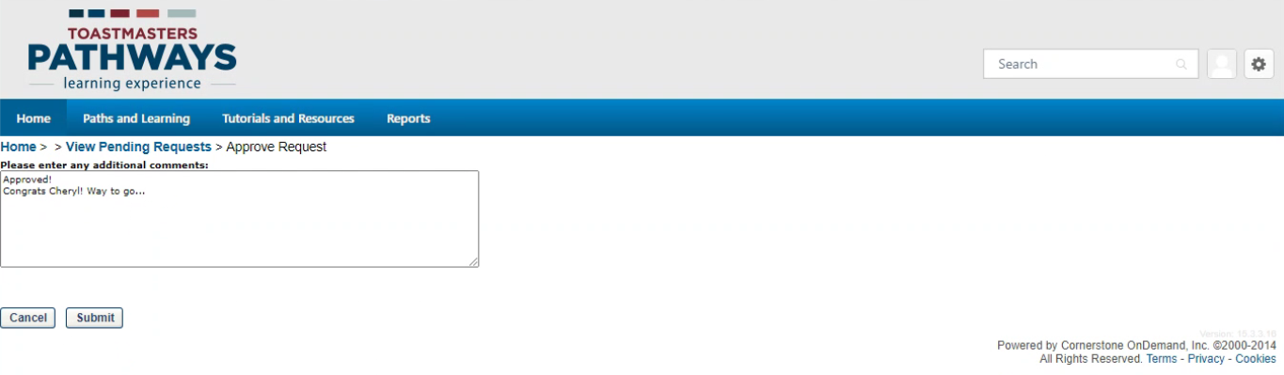
Example Adding Comments
Base Camp Manager also has the option to enter comments when approving or denying a request.

Slide 10
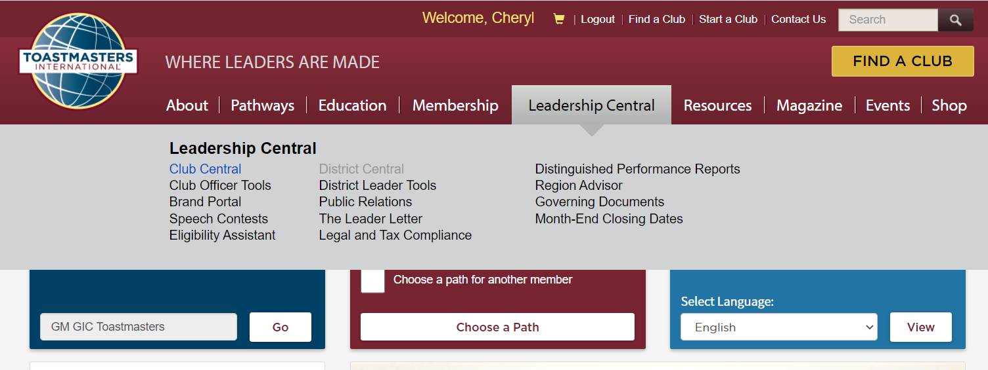
Submit Education Award – via Club Central

Slide 11
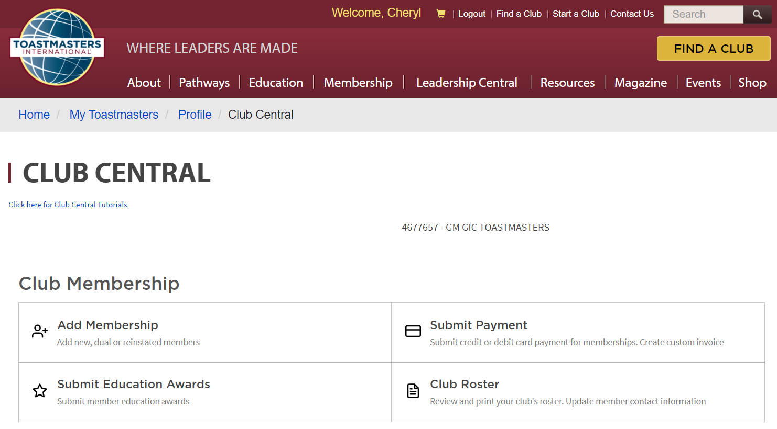
Submit Education Award Link

Slide 12
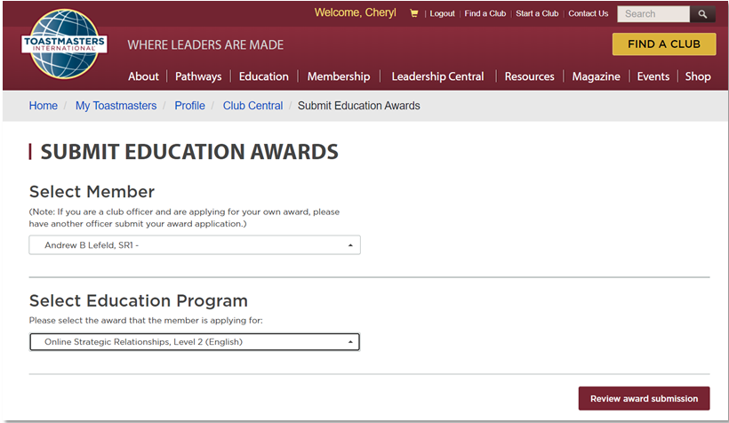
Submit Education Award Form
1
2
3
Notes:
Note that one cannot submit an award for himself/herself.
The Base Camp Manager should check first in basecamp if club members have completed the relevant projects. He/she should also confirm with club members before submitting them for any awards. Base Camp Manager should NEVER submit members’ education awards in Club Central at random just for Distinguished Club Program (DCP) credit, or without confirming with members first.
Whatever level the Base Camp Manager sees in Club Central under the Submit Education Awards section for any member doesn’t mean that that member has finished the path. The level will pop up automatically, even when member just newly purchased a path.
Base Camp Manager needs to be fully aware that the same club can only take 1 credit per member per level. In other words, for instance, if he/she submits 4 level 1 awards for an individual, only 1 of the 4 can be applied towards the club DCP. The others cannot and will just go to trash.

Slide 13
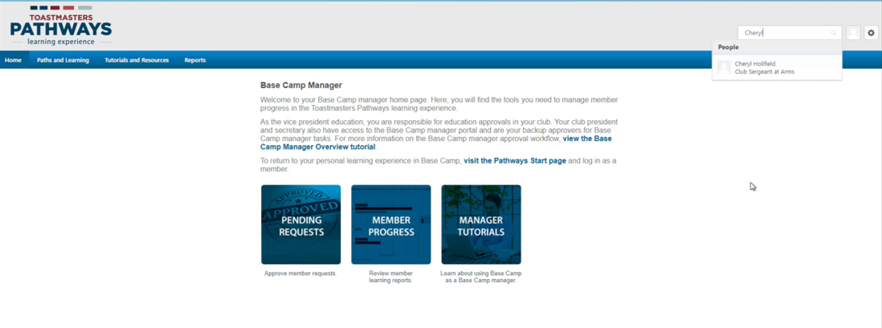
Print Certificates – Search for Club Member
Notes:
One can only search for a club member that’s in the same club as he/she is logged into the site. In other words, if someone is the Base Camp Manager for multiple clubs then he/she can only search for members of the club that he/she is logged in as.

Slide 14
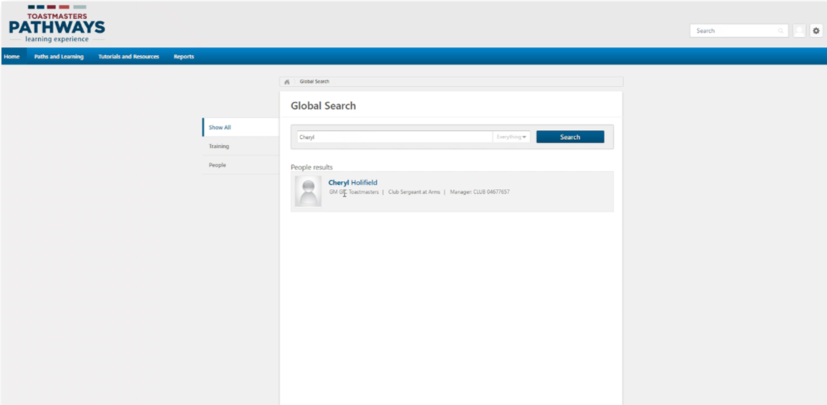
Print Certificates – Select a Club Member

Slide 15
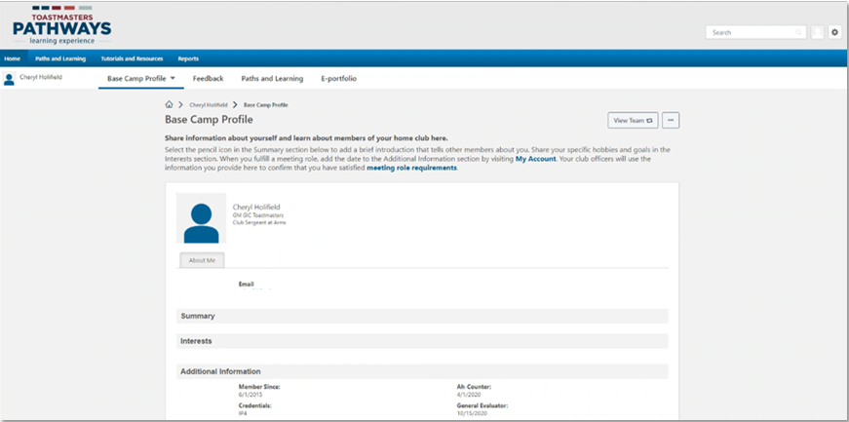
Print Certificates – Go to Paths & Learning
Notes:
1. After selecting a club member, click “Paths and Learning” link on the navigation bar to be able to see the transcript of the selected club member.

Slide 16
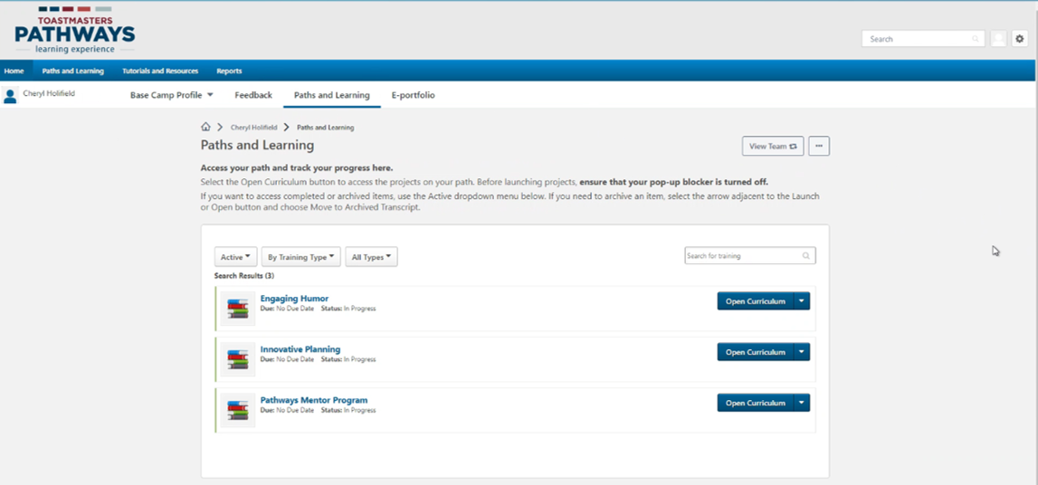
Print Certificates – Open Curriculum

Slide 17
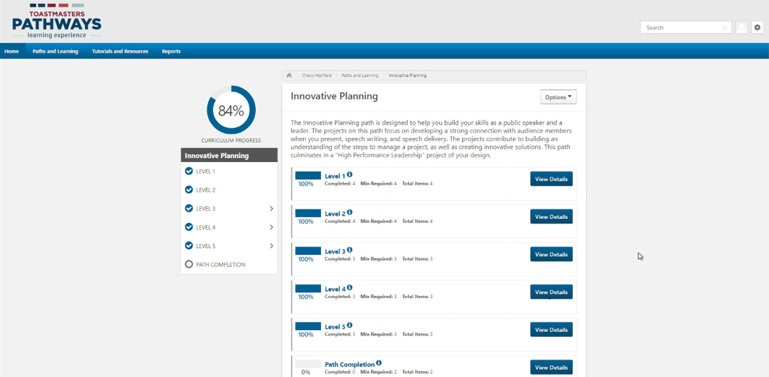
Print Certificates – View Details

Slide 18
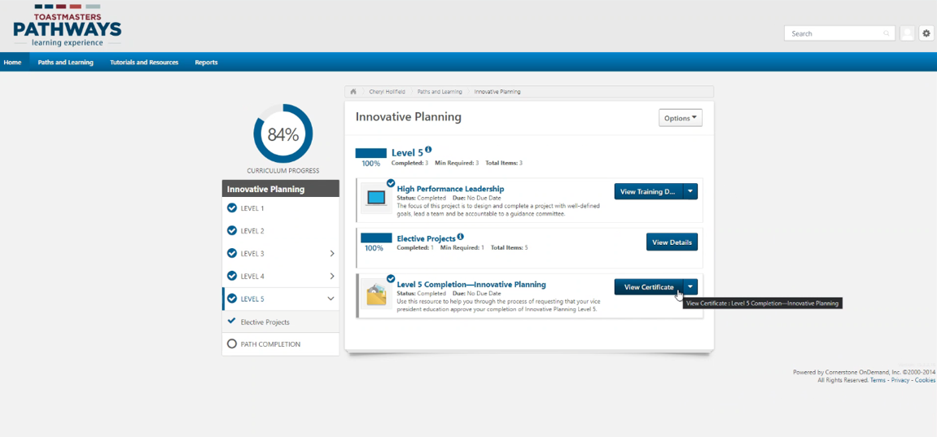
Print Certificates – View Certificate

Slide 19
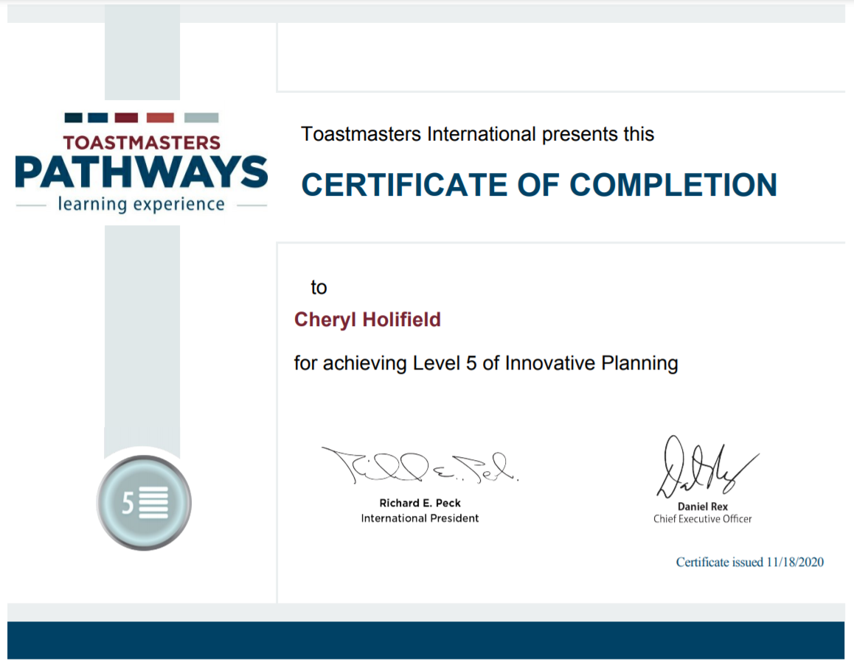
Print Certificates – View the Certificate

Slide 20
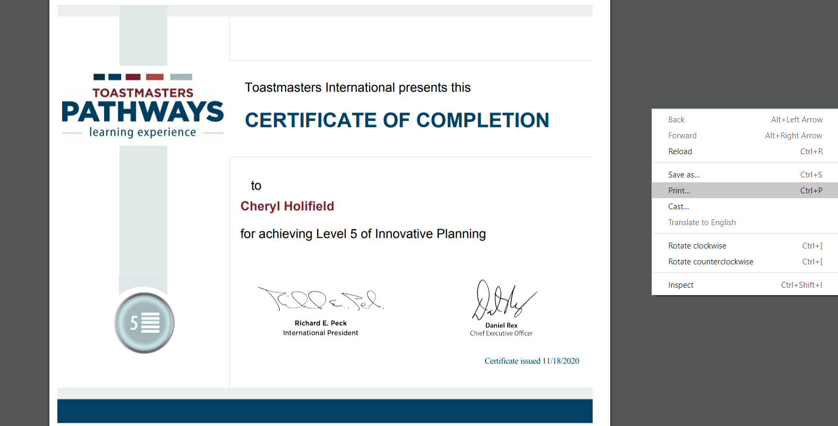
Print Certificates – Print the Certificate
Notes:
1. To see the Print option, right-click on the screen. Another way to print is to print via the browser options.

Slide 21
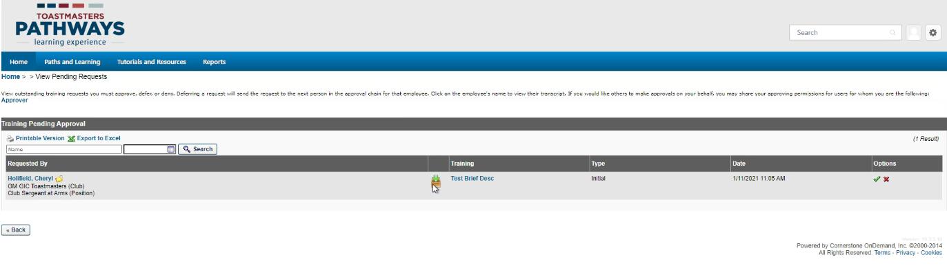
Approve/Deny Ext Training Initial Requests
Click to approve/deny the request
Click to view the details of the training request
Indicator that it is an external training request
“Initial” indicates 1st step in the external training process and that the member needs approval from the VPE
Notes:
When a member wants to complete a speech or assignment outside of their home club, they request approval from the VPE by using the external training feature.

Slide 22
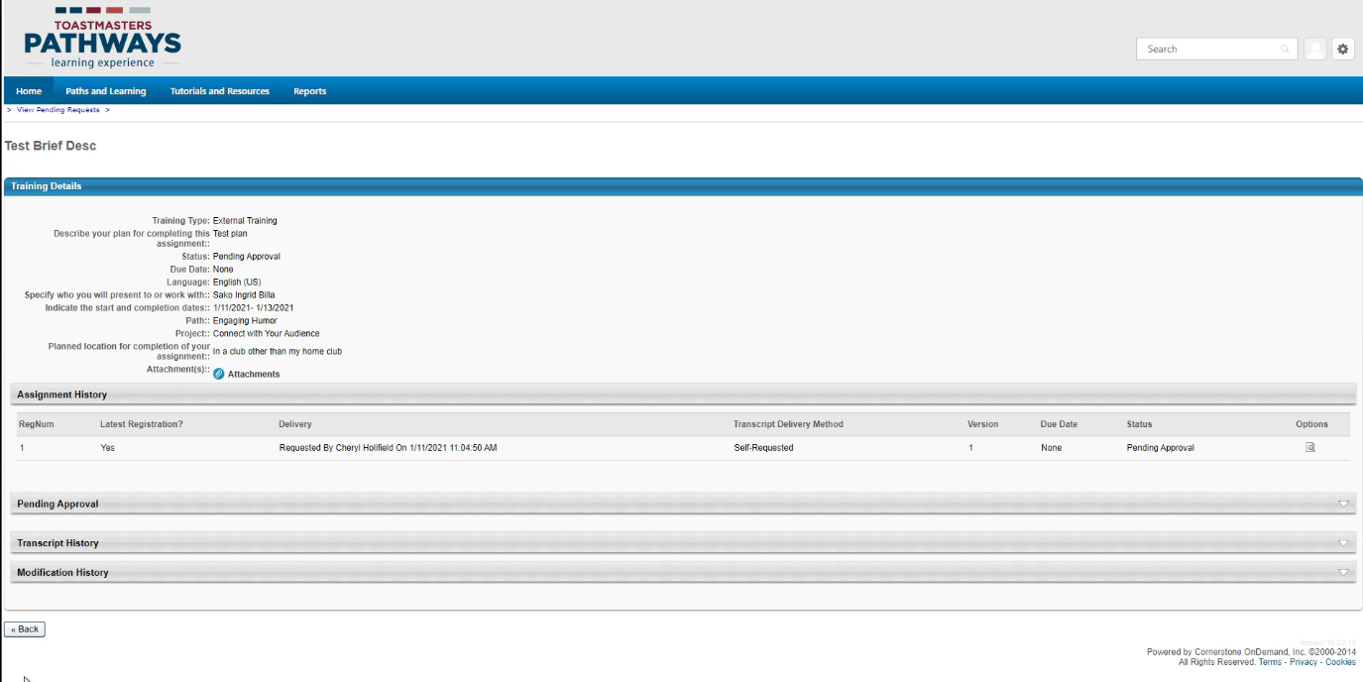
View Details of Training Request

Slide 23
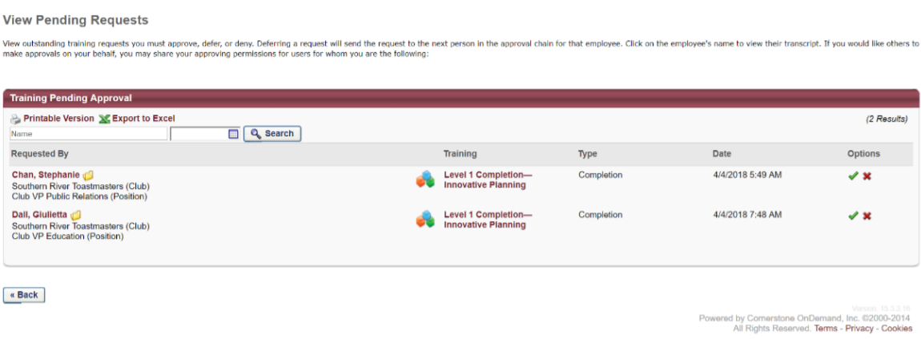
Approve/Deny Ext Training Comp Requests
Click to approve/deny the request
“Completion” indicates that the member completed their assignment
Notes:
1. Example screenshot was taken from District 5 Toastmasters Base Camp Manager Training documentation at the following: https://d5tm.org/wp-content/uploads/2019/01/Pathways-Basecamp_Manager-Manual.pdf.

Slide 24
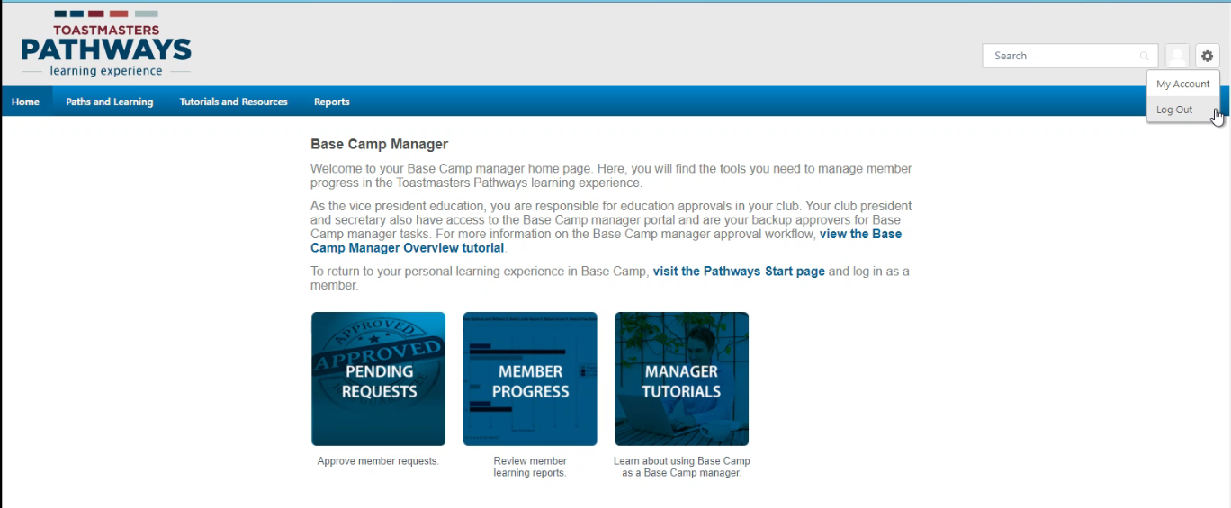
Log Out of Base Camp
Notes:
This option is for logging out of Base Camp. One must log out of the Toastmasters main site as well in order to log out of Toastmasters completely.
Selecting this log out option will return the user to the Toastmasters.org website.

Slide 25
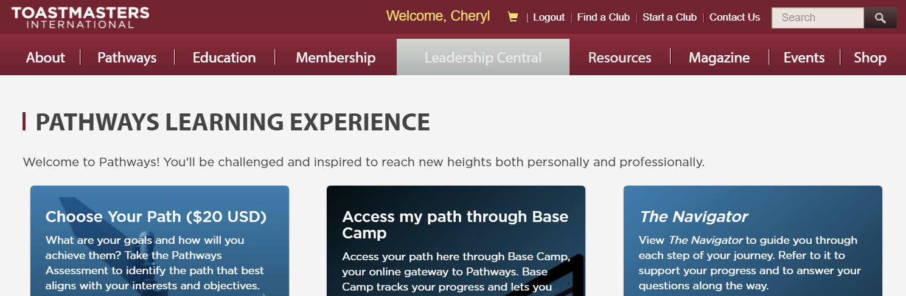
Log Out of Toastmasters

Slide 26
Additional Pathways Resources
Online tutorial videos
Email questions to the Pathways Champions
D44 website
Notes:
In case the first link doesn’t work, note that the additional Base Camp Manager tutorial videos can be accessed via Base Camp. Once logged in, just navigate to the Tutorials and Resources section.

Slide 27
Questions?

