Slide 1
Pathways Overview
Created By: Pathways Champions
Created Date: 12/08/20
Last Modified Date: 01/12/21

Slide 2
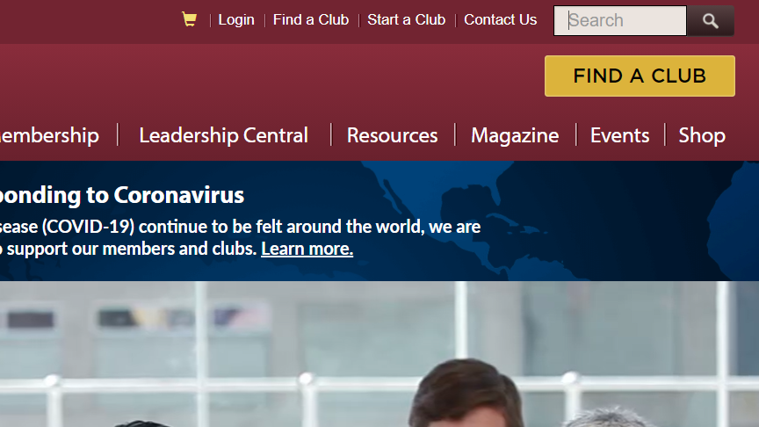
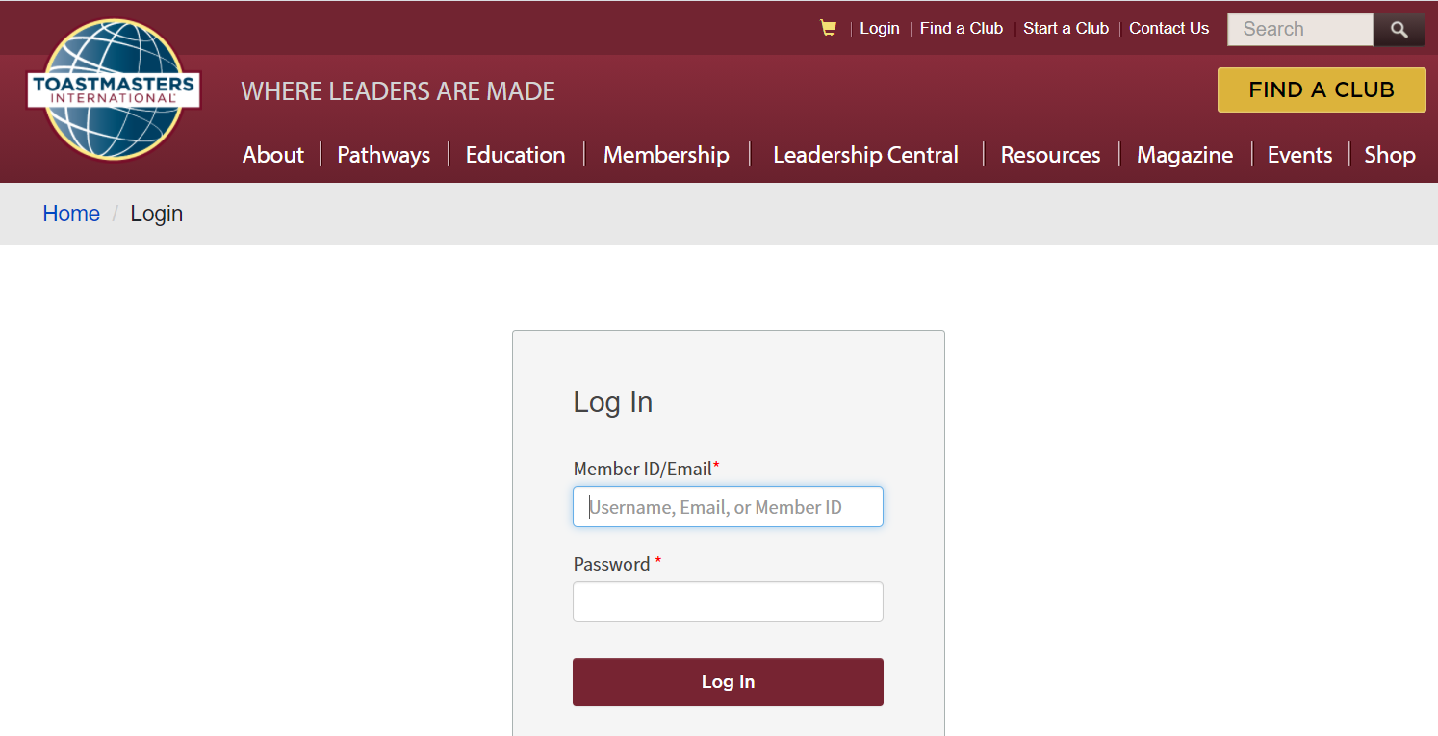
Login to Toastmasters
1
Navigate to the Toastmasters.org site.
Click “Login” on the top menu.
2
3
Enter your member ID or email address, along with
your password.
Click the “Log In” button.
4

Slide 3
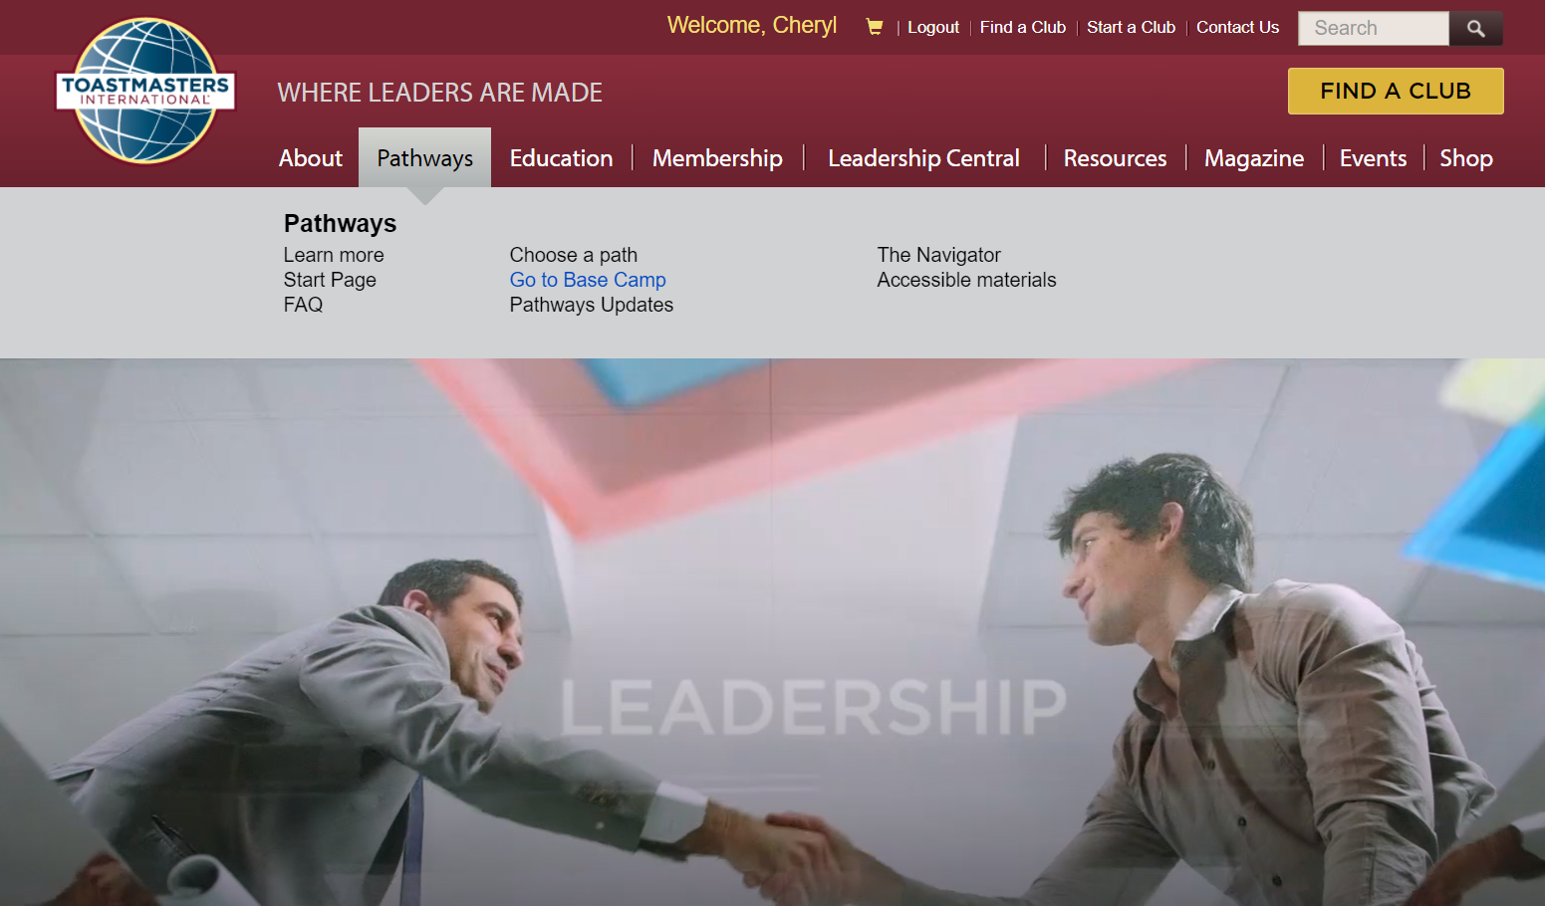
Choose a Path – via Pathways Menu
1
or
2
2
Notes:
After logging in, one should see “Welcome, <Your Name>” as a link on the top menu.
To choose a path, one must select the Pathways menu option. Then he/she can click either “Start Page” or “Choose a path”.

Slide 4
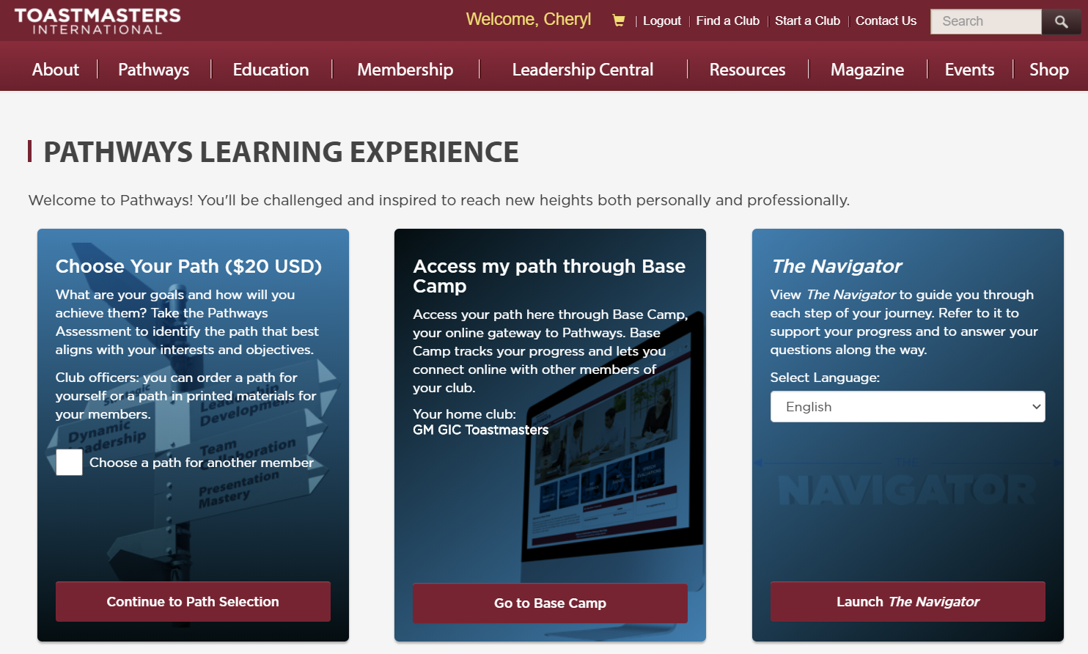
Start Page –> Continue to Path Selection
Notes:
After clicking “Start Page”, the Pathways Learning Experience page displays.
Click the “Continue to Path Selection” to be redirected to the “Choose a Path: Select Your Preferences” page.

Slide 5
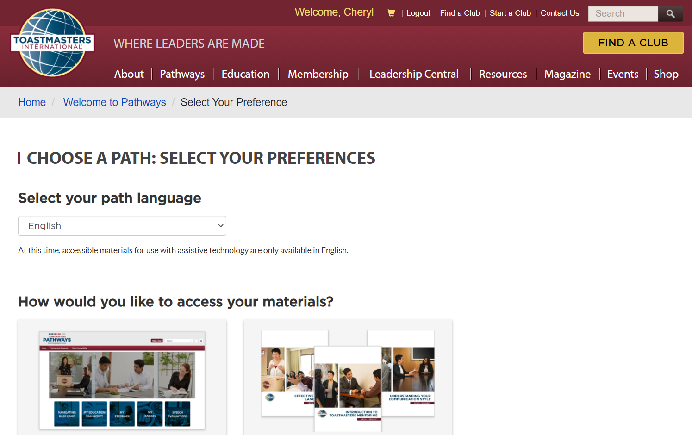
Choose a Path –> Select Your Preferences
Notes:
After clicking “Choose a Path”, the “Choose A Path: Select Your Preferences” page displays.
2. The club member can select his/her preferences, e.g. their path’s language, if they prefer digital vs. printed materials, the path they want to take.

Slide 6
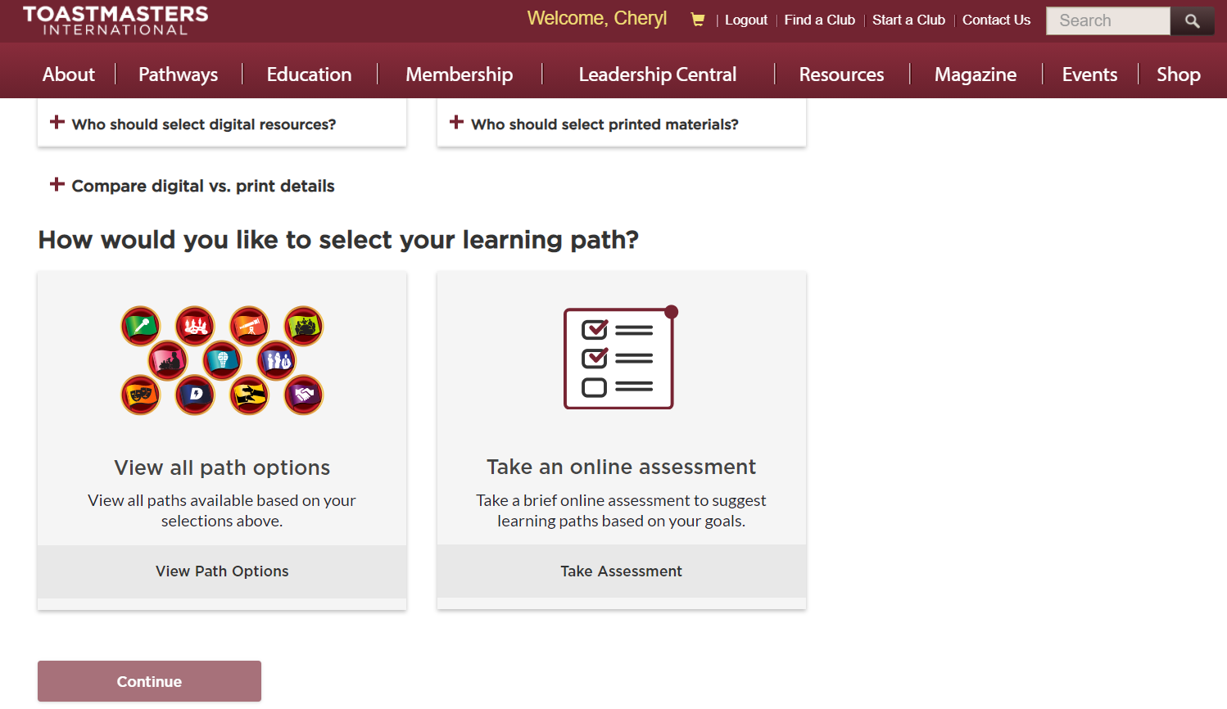
Take the Online Assessment
Notes:
One can also take an online assessment to have a path recommended for them.

Slide 7
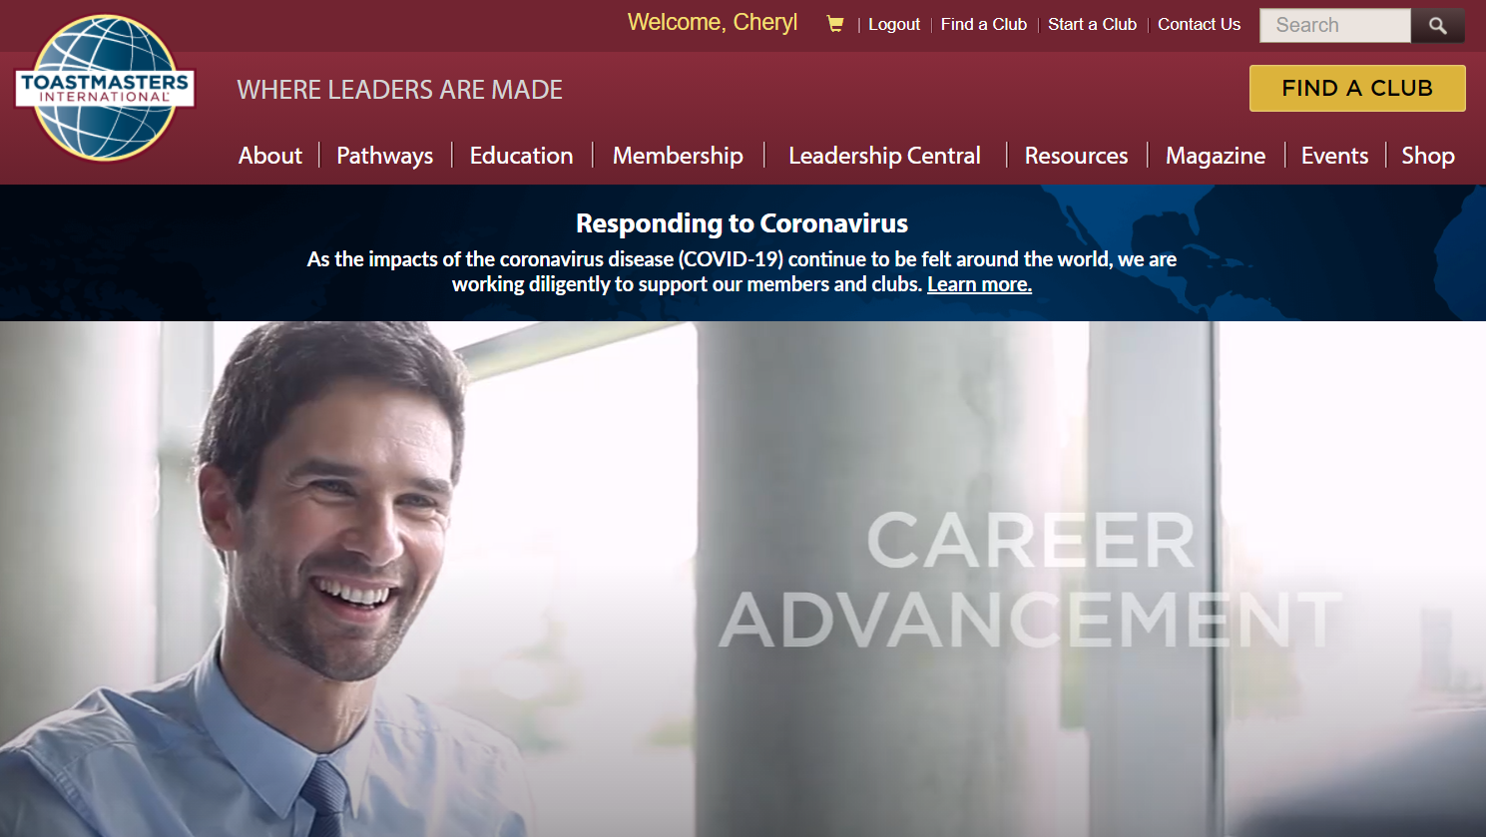
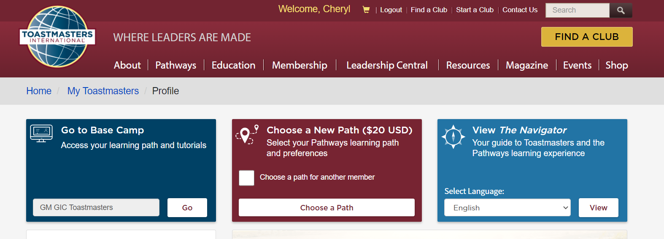
Choose a Path – via Welcome Menu
Notes:
Another way to choose a path is by clicking on the “Welcome <Your Name>” link on the top menu. Then click “Choose a Path”.
The user is redirected to the “Choose a Path: Select Your Preferences” page previously discussed.

Slide 8
Navigate to Base Camp
1
2

Slide 9
Navigate to Base Camp – Alternate Way
1
2

Slide 10
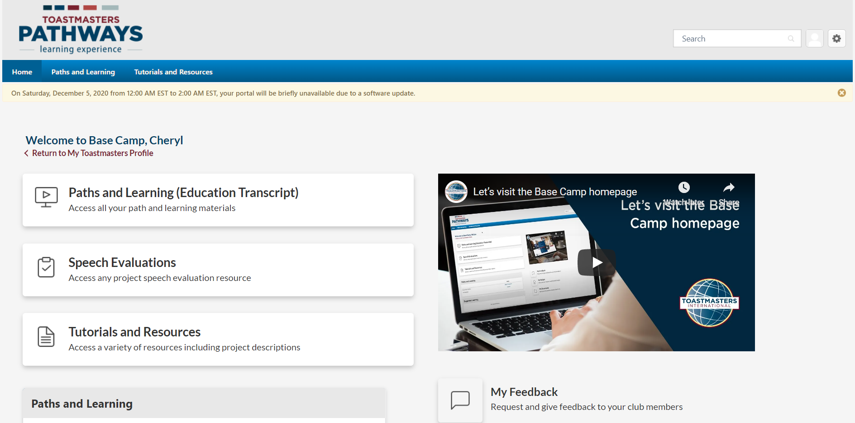
View Base Camp Home Page

Slide 11
Go To Paths and Learning Page

Slide 12
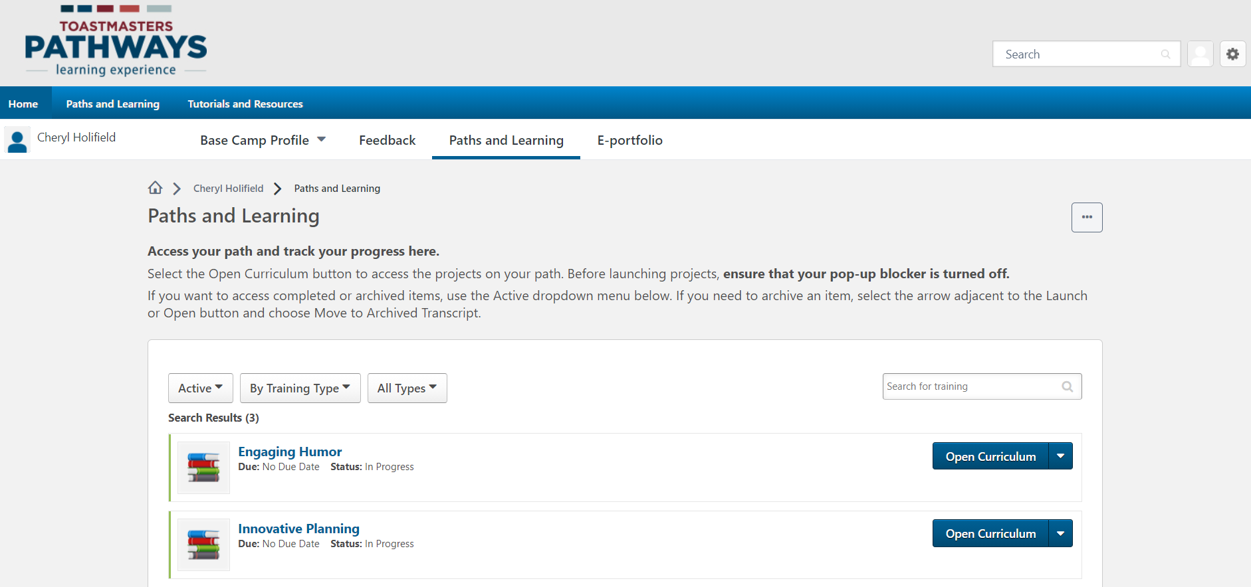
View Paths and Learning Page
Notes:
Base Camp’s Paths and Learning screen displays.
One must click the “Open Curriculum” button next to a specific path in order to view that path.

Slide 13
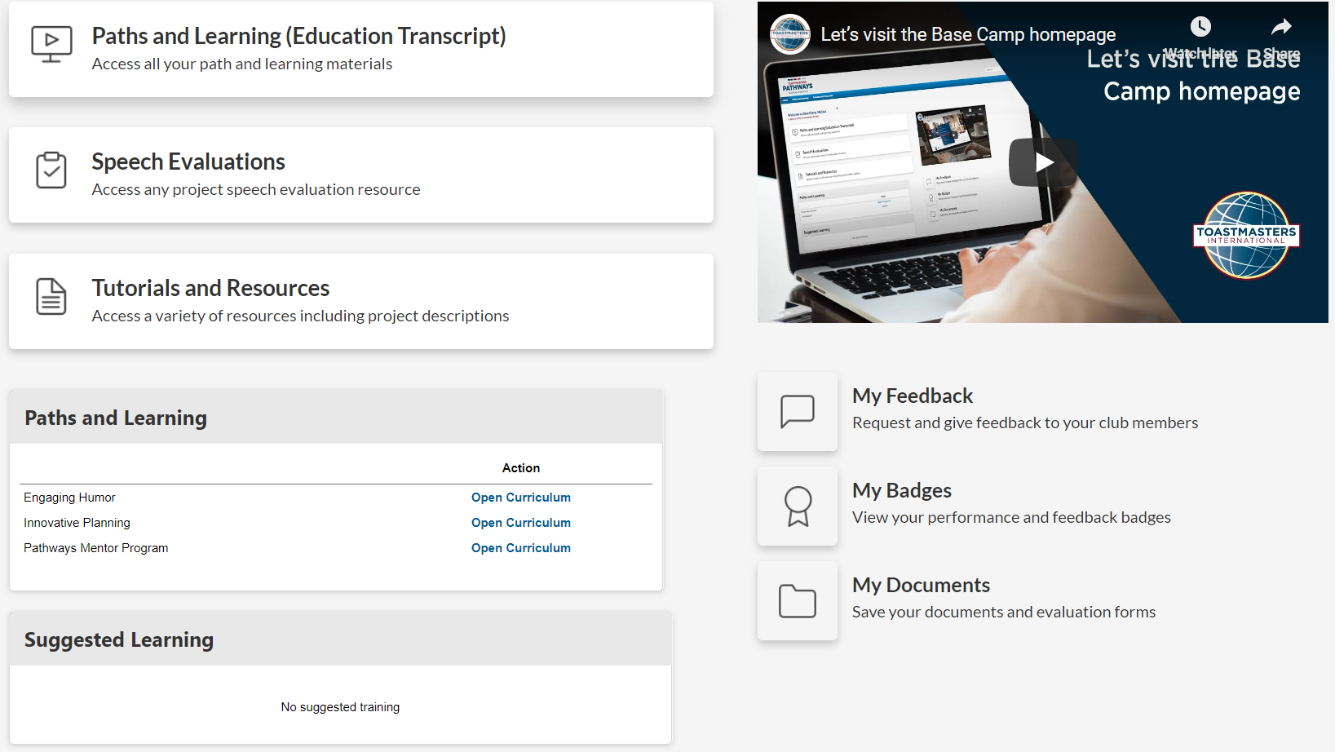
Go To a Specific Path’s Curriculum
Notes:
Scroll down the page to view the “Paths and Learning” section. Click “Open Curriculum” next to a path to view that path.
Note that this section only displays up to 3 items.

Slide 14
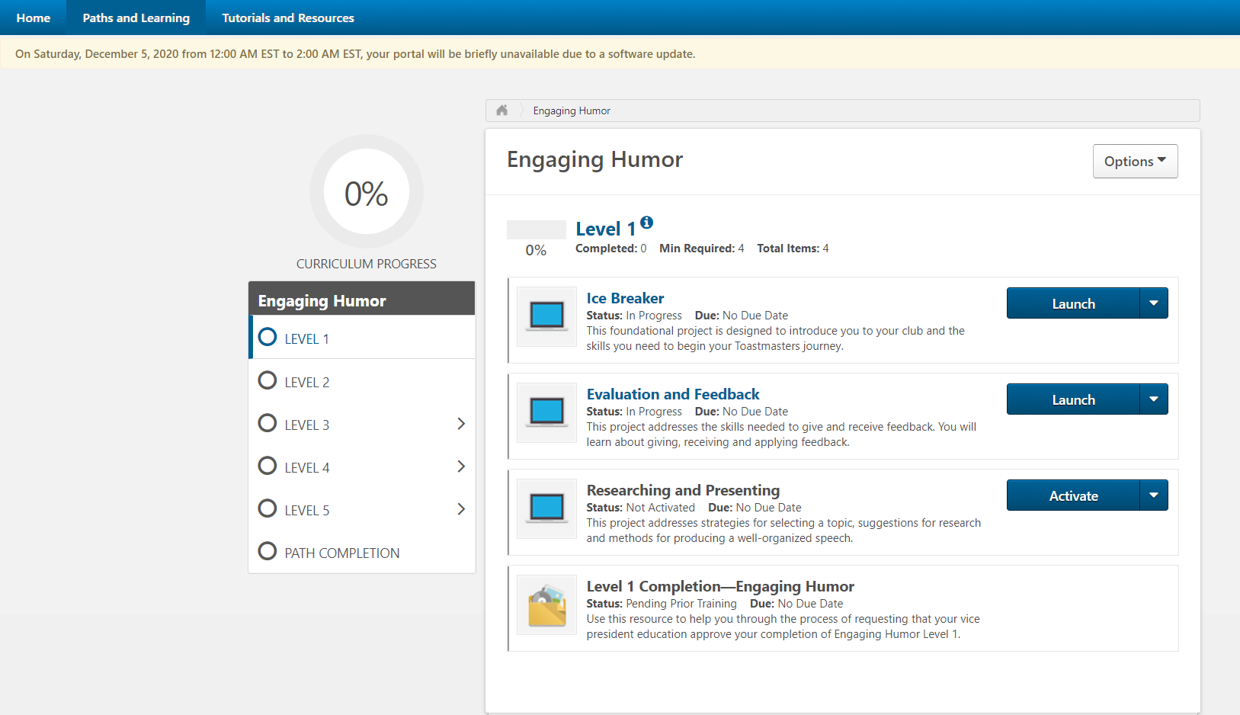
View a Path
Displays the completed and minimum items required for the selected level.
Displays percentage of the path completed.
Use to navigate between the levels of a path.
Lists the projects available for the selected level.
Use the Activate & Launch buttons to start and launch a project.
Notes:
Club members should launch each project and ensure to navigate through each lesson.
One must complete the min # of required items displayed to complete the level. Some levels include elective projects in which 1-2 speeches must be completed before advancing on. Please ensure to read carefully.

Slide 15


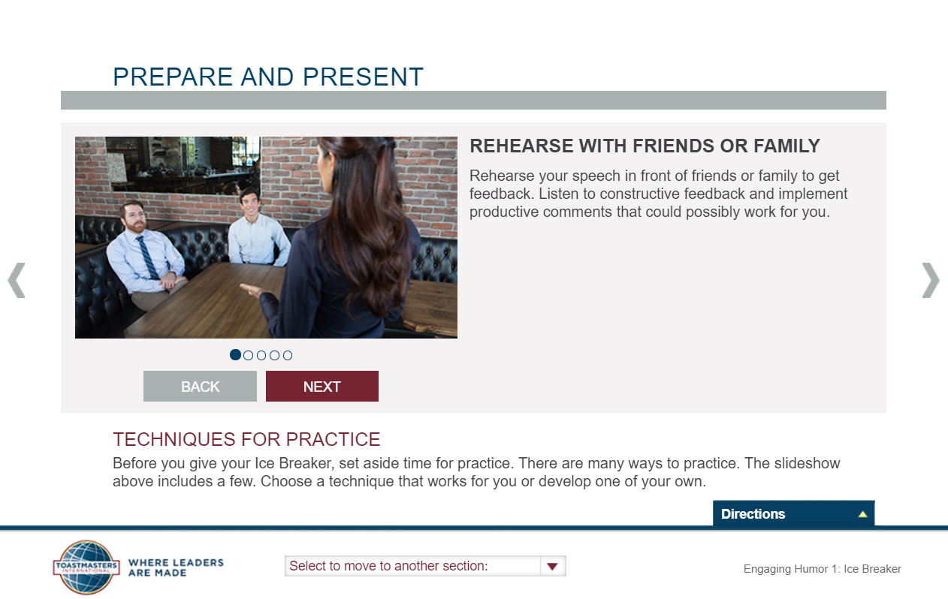
Launch a Project
Loading messages appear.
Project module displays.

Slide 16
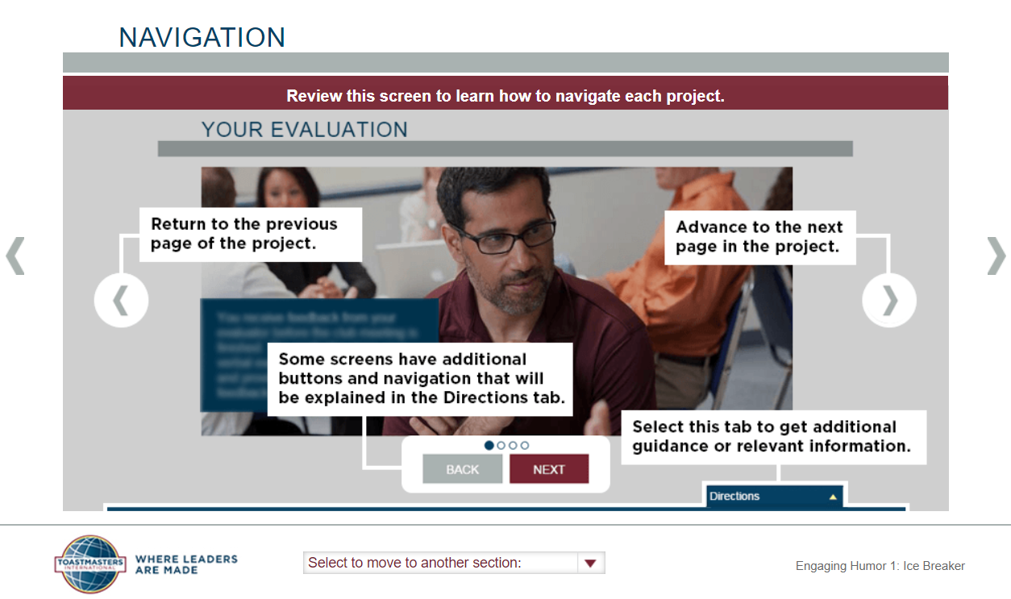
Navigate Through a Project

Slide 17
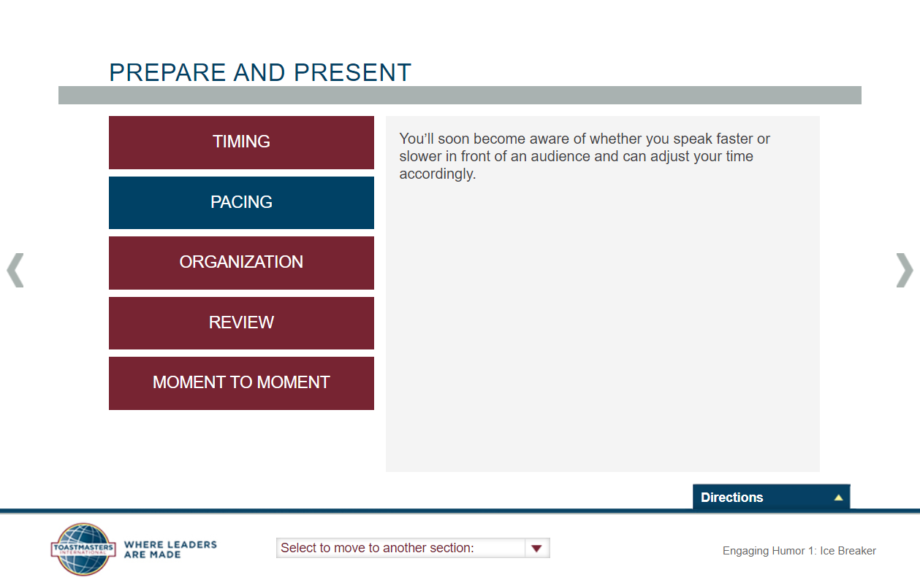
Red/Blue Navigational Buttons
Some screens consist of multiple buttons used to provide additional information. Therefore, club members must ensure to click through all that are displayed.
The blue color signifies which button is currently active.

Slide 18
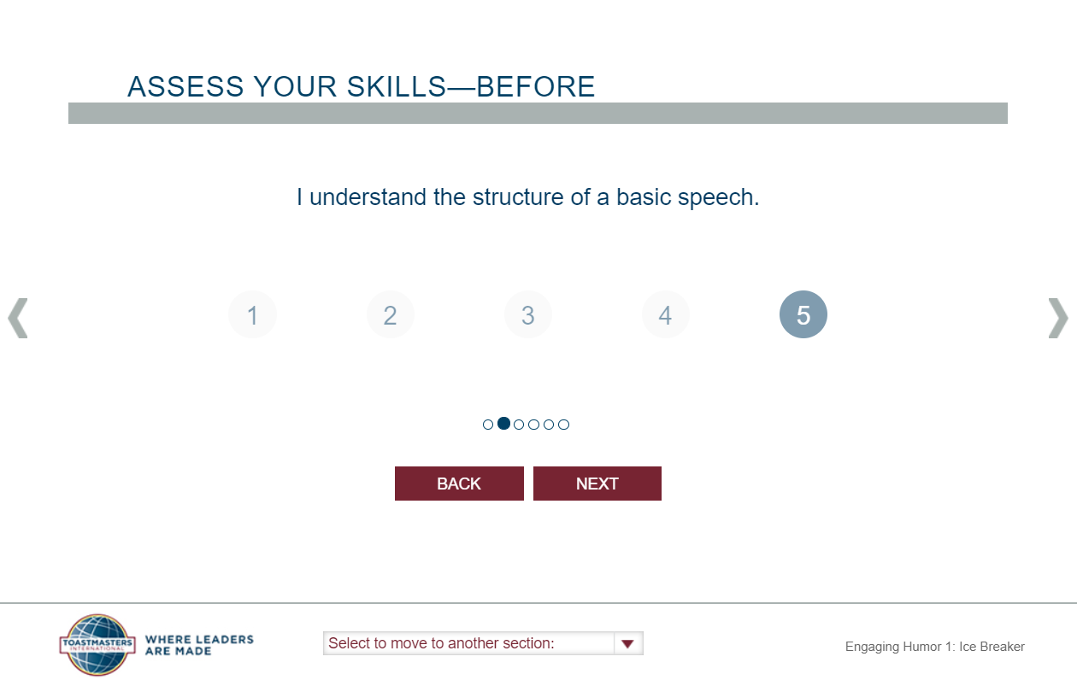
Assess Your Skills – Before
There is a pre-assessment contained within each project module. Take the pre-assessment before completing a project.
Make sure to answer all the questions by clicking the “Next” button at the bottom to navigate through until no further questions remain.
Notes:
1. The purpose of the pre-assessment is to assess the Toastmasters knowledge before completing the project.

Slide 19
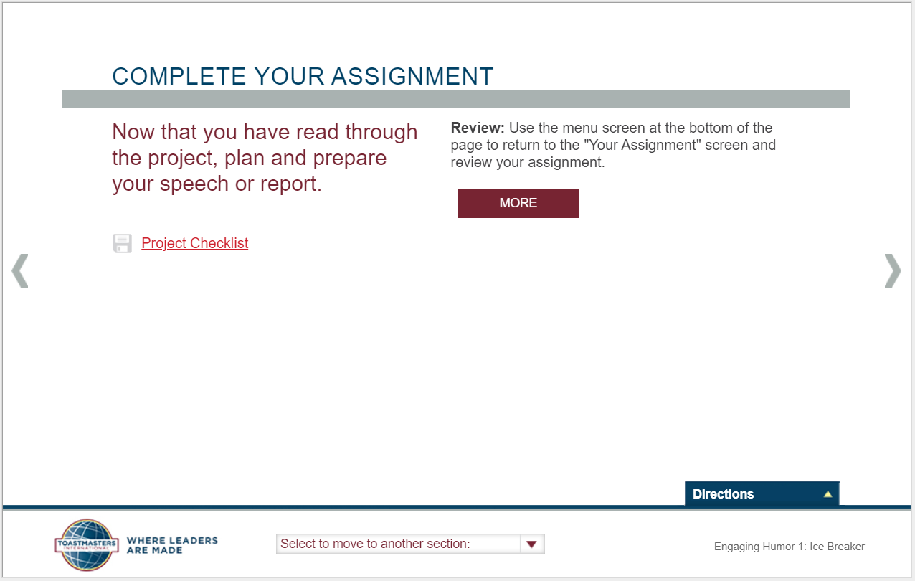
View the Assignment
On this page, one can access the project checklist. To open, just click the “Project Checklist” link, and the associating file will open.
The file lists the items which are to be completed for the project and allows for one to document notes if desired.

Slide 20
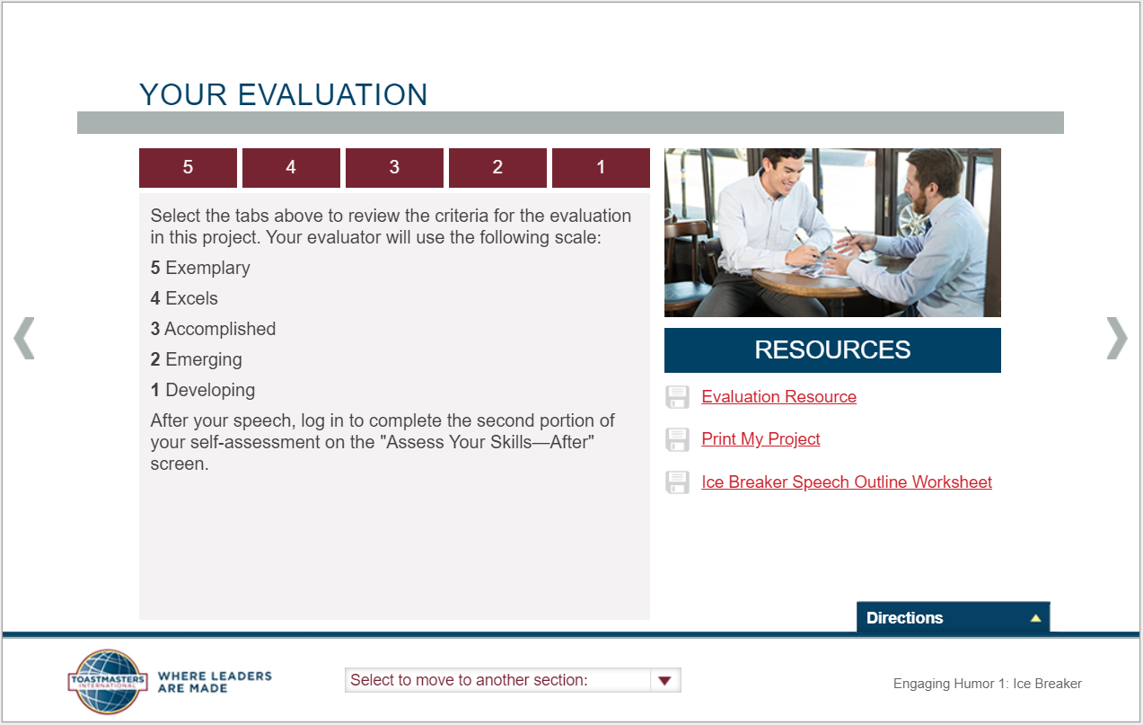
Access the Evaluation Form
On this page, one can access the speech evaluation form. To open, just click the “Evaluation Resource” link.
One can also print the project from this page.
Some projects also include links to supporting documentation to further help facilitate the project’s lesson.

Slide 21
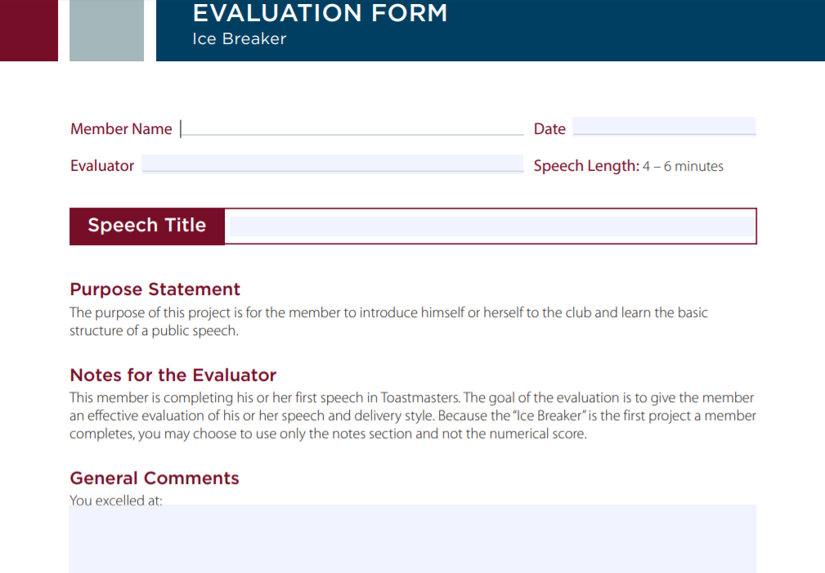
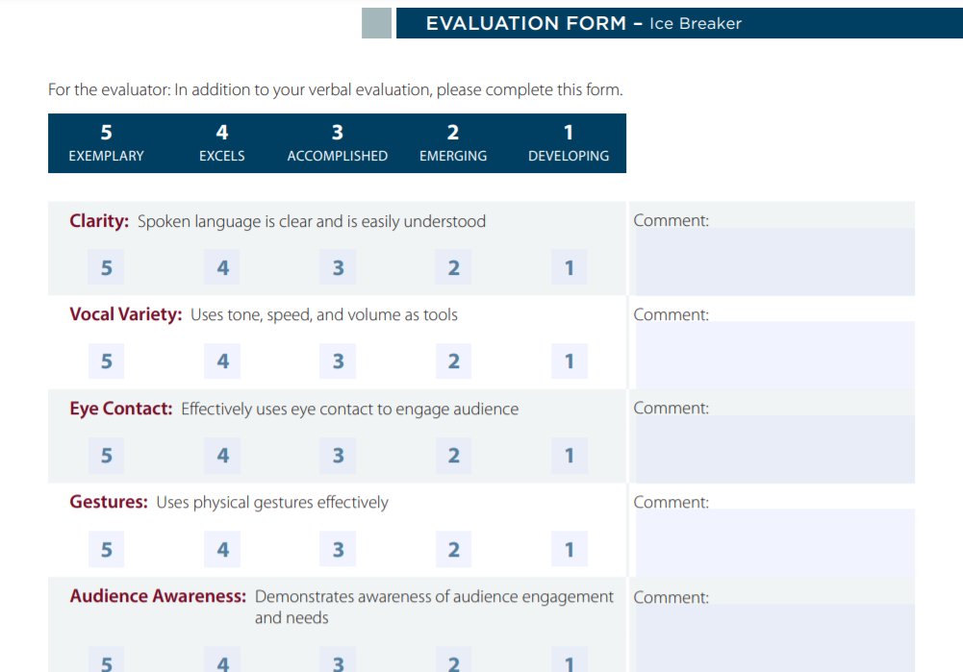
Sample Evaluation Form
Notes:
Just as a reminder, the evaluation form accessible via the project module is not fillable. One can get a fillable PDF via the Speech Evaluations link on the Base Camp home page or via their club’s FreeToastHost website if the person being evaluated has already selected his/her speech project.
The evaluee should make sure to upload the completed evaluation form to the e-portfolio/documents area (to be later covered in the presentation).

Slide 22
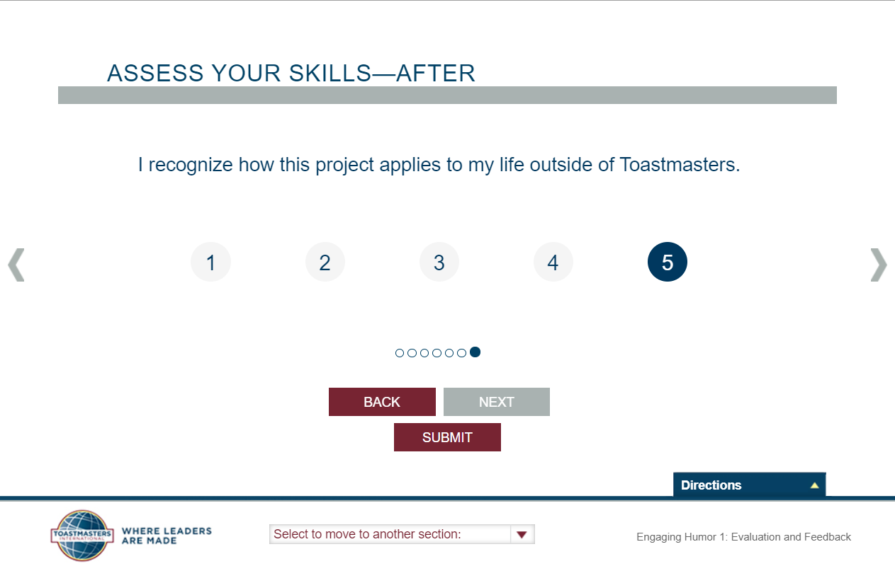
Assess Your Skills – After
There is a post-assessment contained within each project module. Take the post-assessment after the project is complete.
Make sure to answer all the questions by clicking the “Next” button at the bottom to navigate through until no further questions remain.
After all questions have been answered, one should see a “Submit” button displayed. Make sure to click “Submit” for the project to be marked as completed.
Notes:
The purpose of the post-assessment is to assess the Toastmasters knowledge after completing the project.

Slide 23
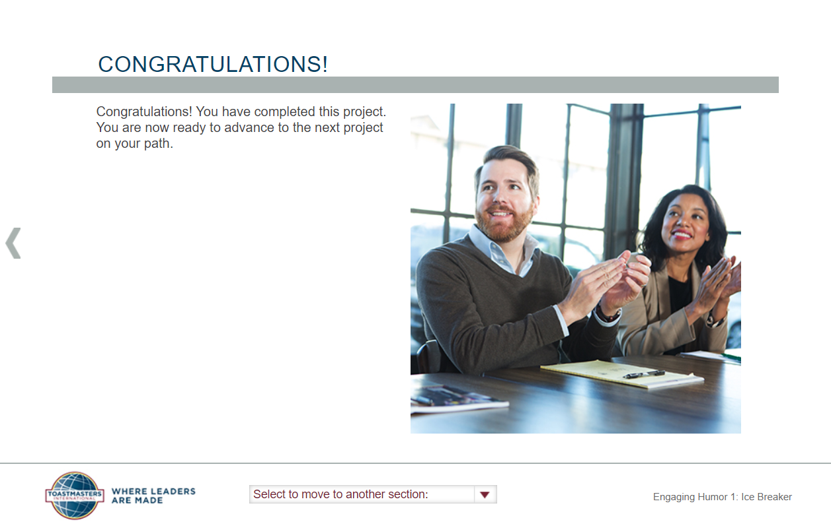
Complete a Project
Once the post-assessment is complete, a “Congratulations” screen displays.
Notes:
1. A checkmark will appear next to the project to signify that it has been completed. The checkmark will appear on the path’s curriculum page.

Slide 24
Additional Pathways Resources
Online tutorial videos
Email questions to the Pathways Champions
D44 website
Notes:
In case the first link above doesn’t work, note that additional online tutorial videos can be accessed via Base Camp. Once logged in, just navigate to the Tutorials and Resources section.

Slide 25
Questions?

