Slide 1
Pathways Overview
Created By: Pathways Champions
Created Date: 12/08/20
Last Modified Date: 01/12/21

Slide 2
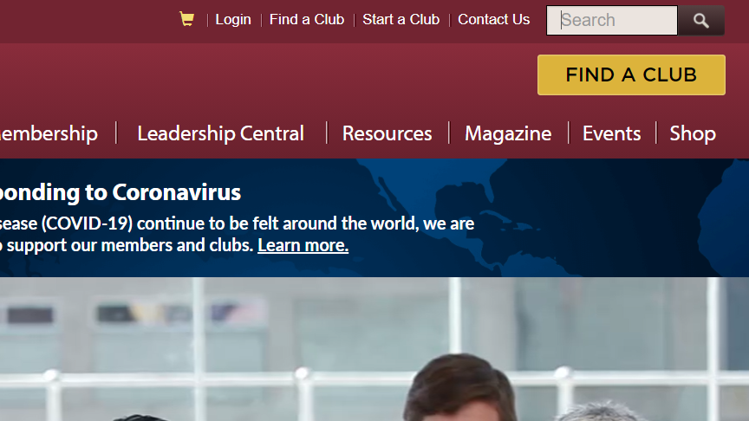
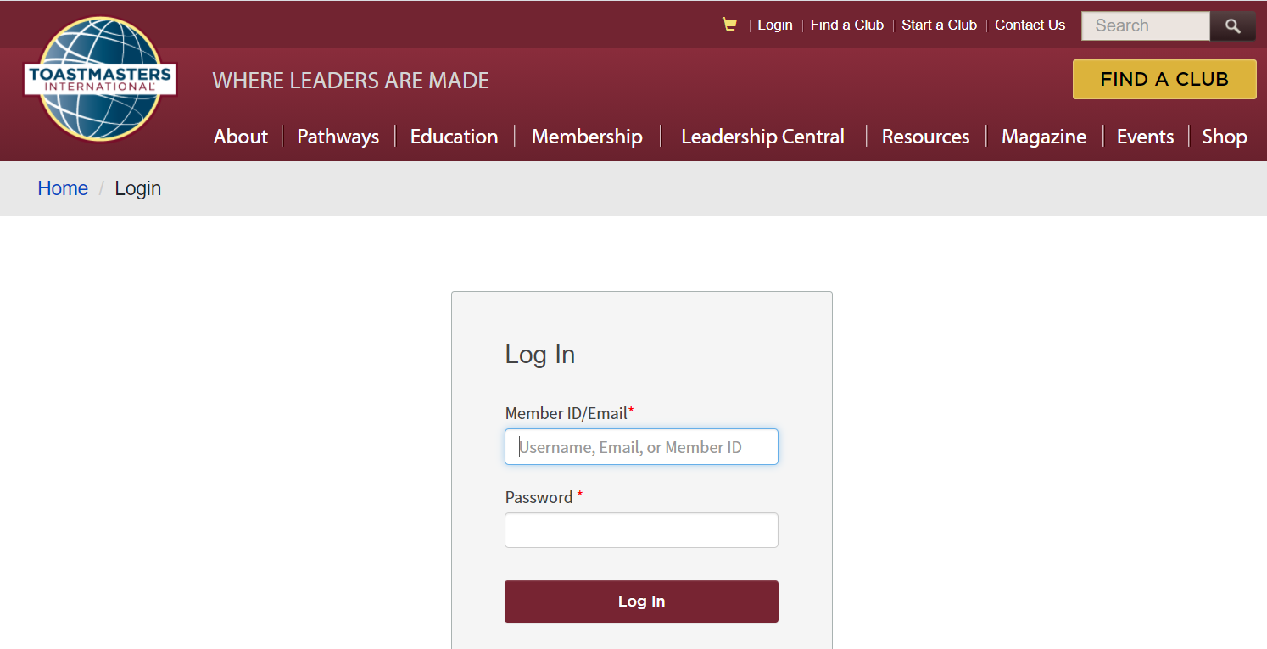
Login to Toastmasters
1
Navigate to the Toastmasters.org site.
Click “Login” on the top menu.
2
3
Enter your member ID or email address, along with
your password.
Click the “Log In” button.
4

Slide 3
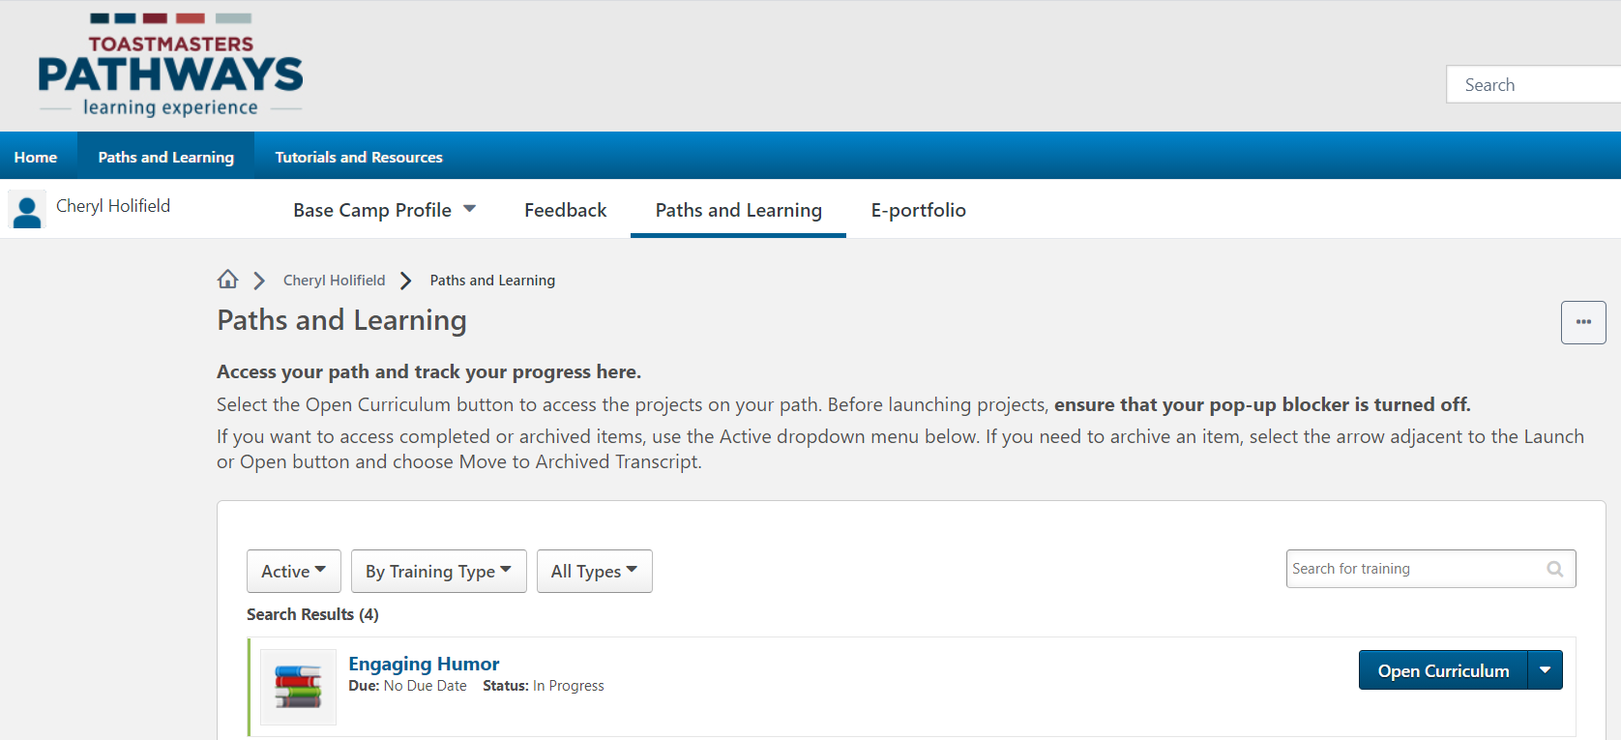
Use the Base Camp Navigation Bar

Slide 4
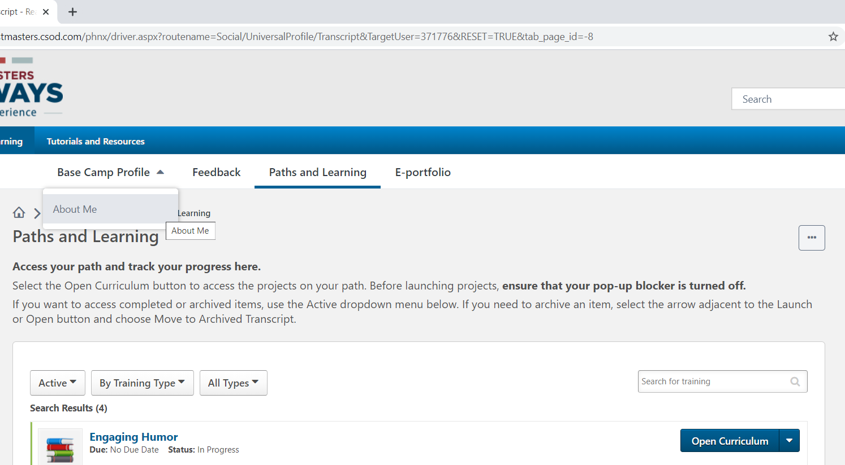
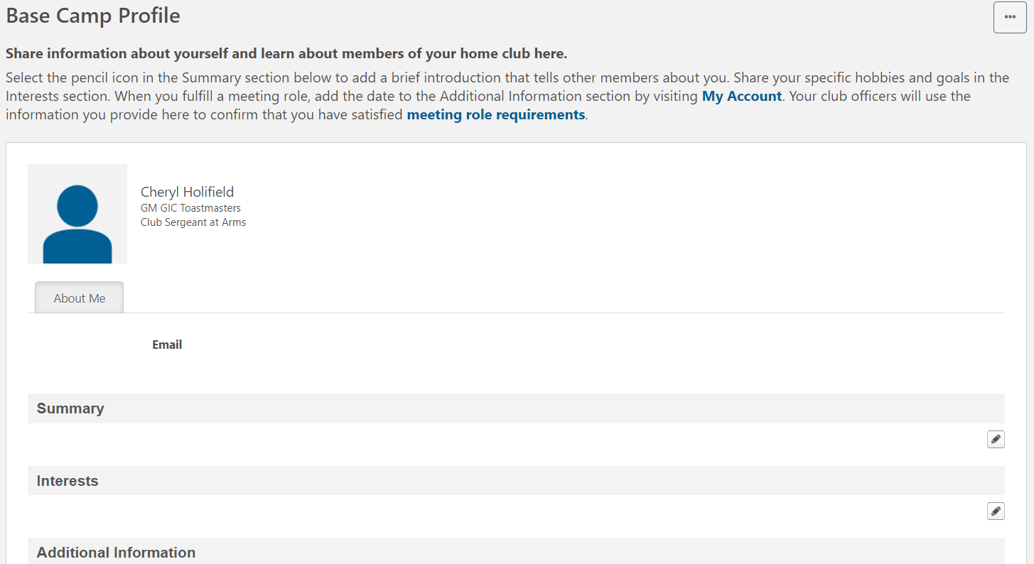
Access Your Base Camp Profile

Slide 5
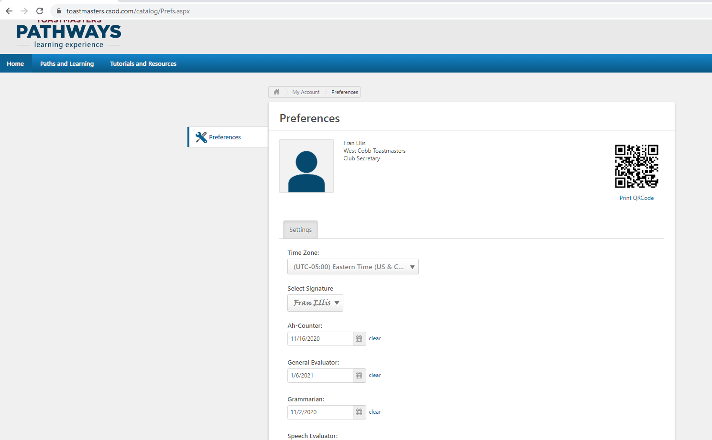
Record the date you performed meeting roles
Notes:
Toastmaster, Table Topics Master, and Evaluator roles are required by the completion of Level 3 in every path.

Slide 6
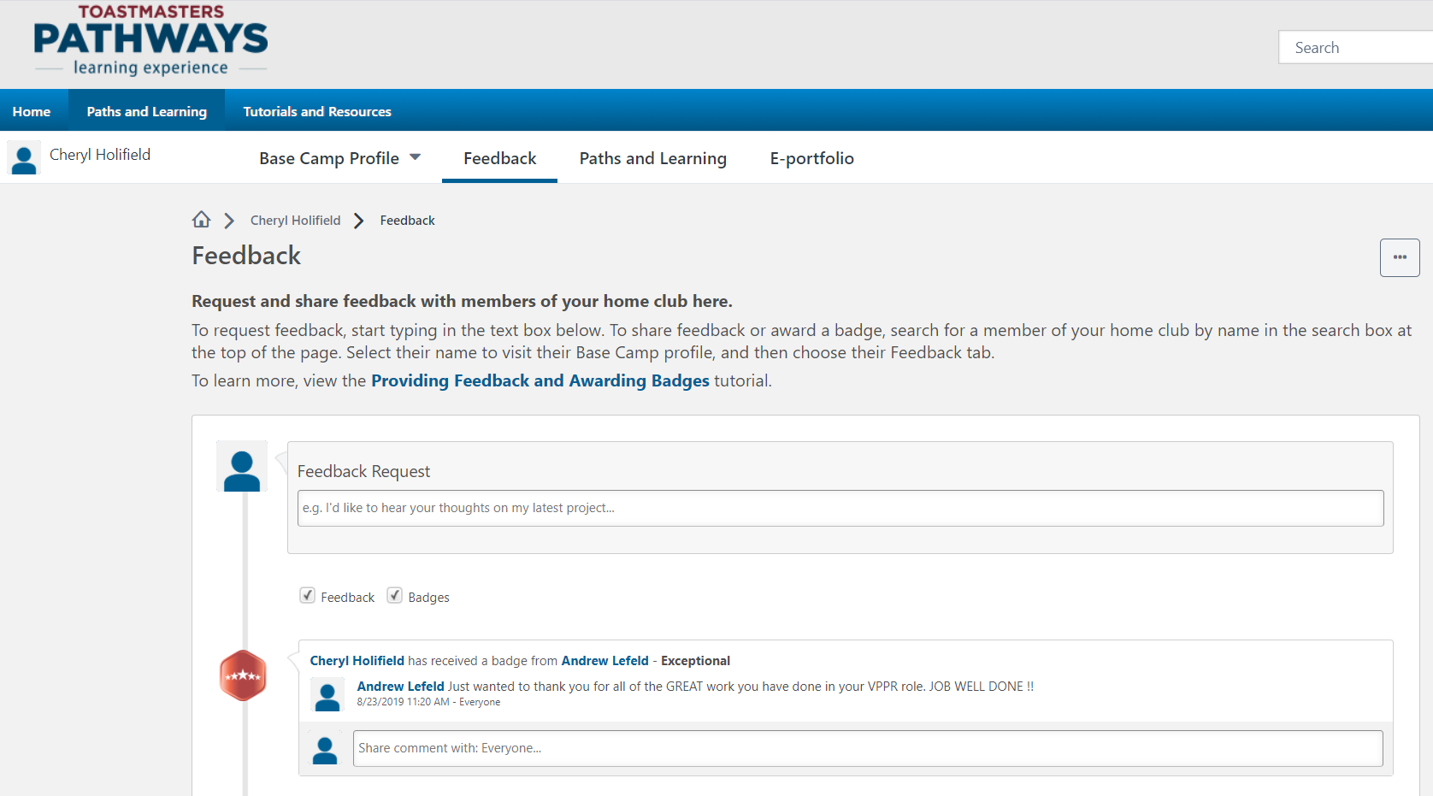
Request Feedback
Here, one can request feedback from club members regarding his/her speeches. He/she can also view all the feedback received.

Slide 7
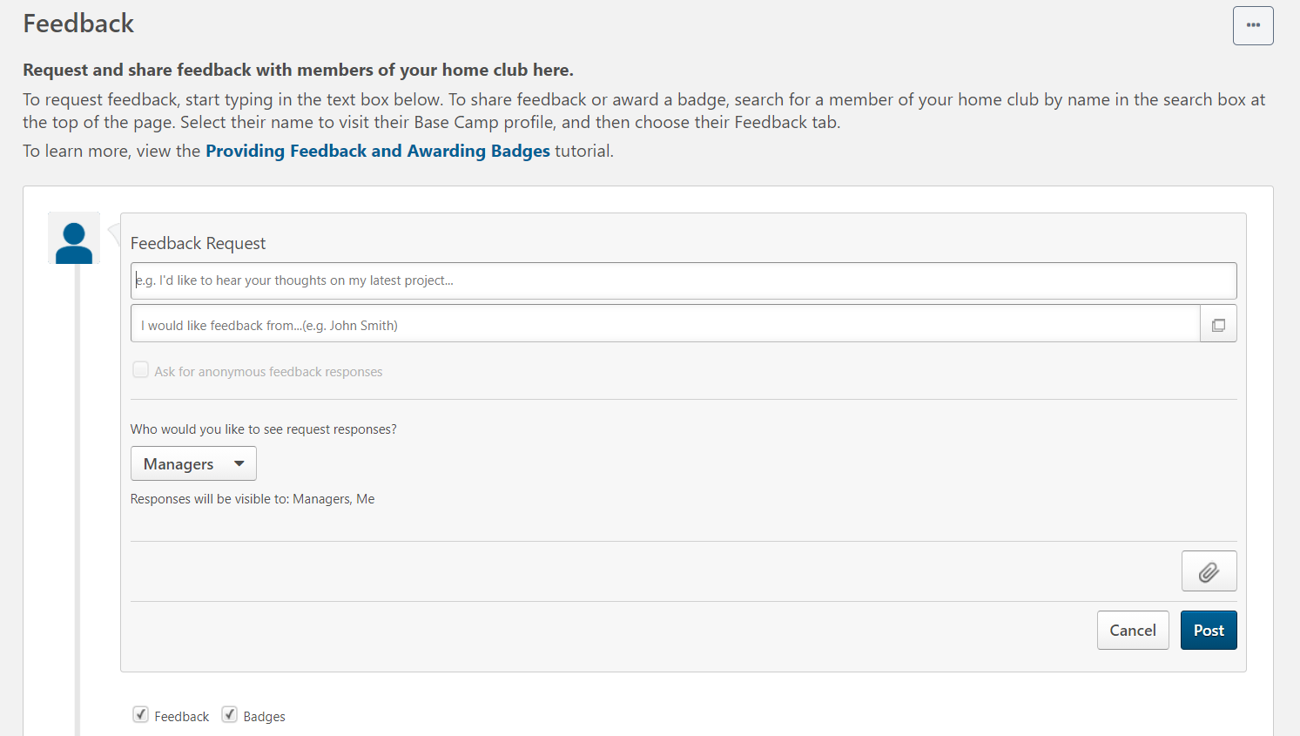
Request Feedback (cont’d)
Enter the feedback request.
Enter the people whom the request should be sent to.
Select if the feedback should be anonymous.
Add attachments, if any.
Designate who can see the responses.
Opt to view the feedback and/or badge sections.
Click to cancel the request.
Click to send/post the request.
Notes:
One must click inside of the Feedback Request textbox to see the other fields.
Once the request has been submitted, the individuals added to receive the request will receive an email.

Slide 8
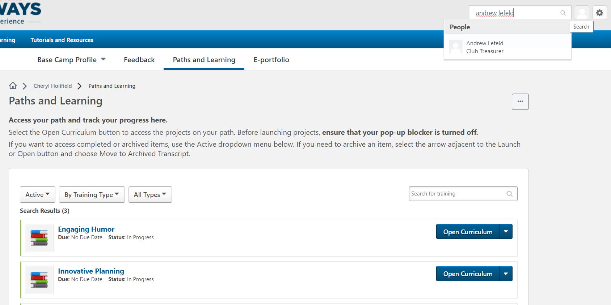
Award a Badge – Search for a Club Member
Notes:
1. One can only submit feedback or a badge to someone in the club for which he/she is logged into the site. In other words, if someone is a member of multiple clubs then he/she can only submit feedback and badges for members of the club that he/she is logged in as.

Slide 9
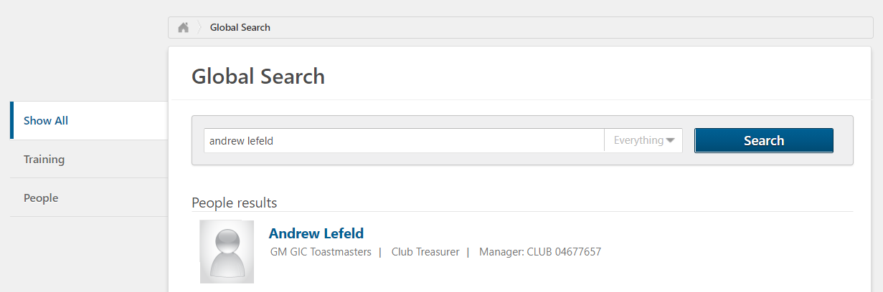
Award a Badge – Select the Club Member
After clicking the search icon, a listing of the club members that match the search criteria is displayed. One must click the name of the user that he/she wants to submit a badge for.

Slide 10
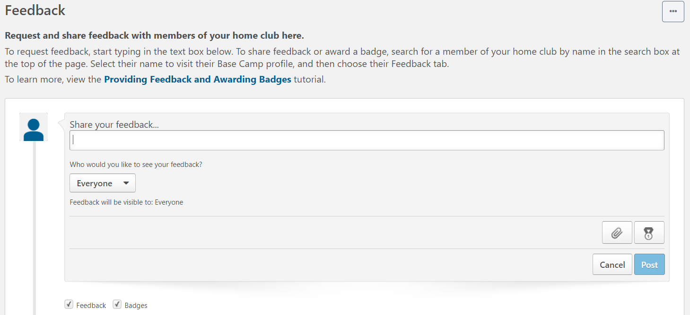
Award a Badge
Enter a brief description for the award.
Add attachments, if any.
Designate who can see the feedback.
Select the type of badge to award.
Click to cancel the request.
Click to send/post the request.
Opt to view the feedback and/or badge sections.
Notes:
One must click inside of the “Share your feedback” textbox to see the other fields.
There are 6 types of badges that can be awarded. They are Adaptable, Collaborative, Courageous, Exceptional, Innovative, and Inspirational.
As a note, one also receives badges when a path is activated and when he/she completes a level.

Slide 11
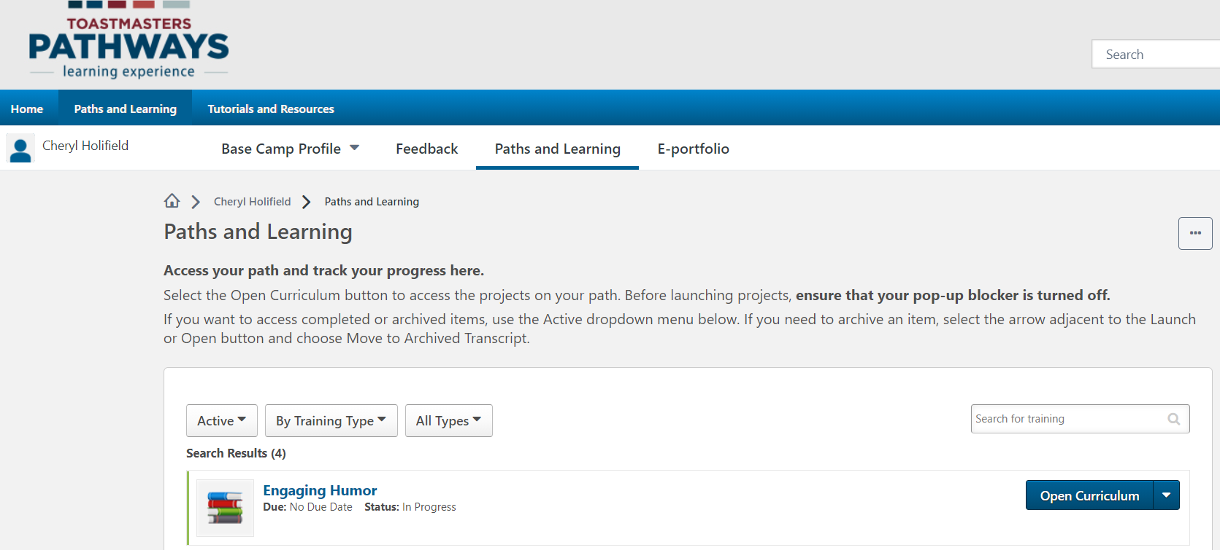
Access Paths and Learning
The Paths and Learning page lists all the paths and training modules that one has signed up to take.

Slide 12
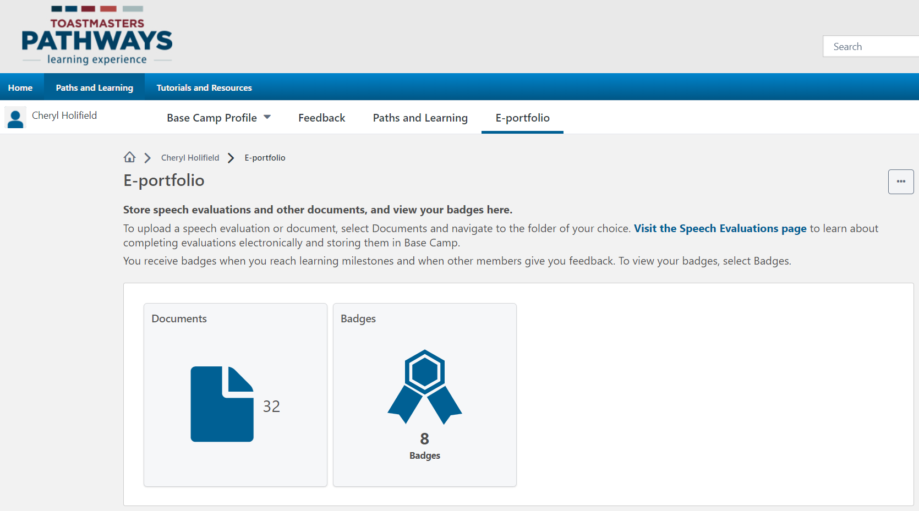
Access E-portfolio
E-portfolio is where one can upload his/her documents and view the badges awarded to him/her. Make sure to always upload completed evaluation forms to the documents folder.
Notes:
If one does a speech outside of their home club, he/she should send the completed evaluation form to the VPE of their club, in addition to uploading it to their Documents folder.

Slide 13
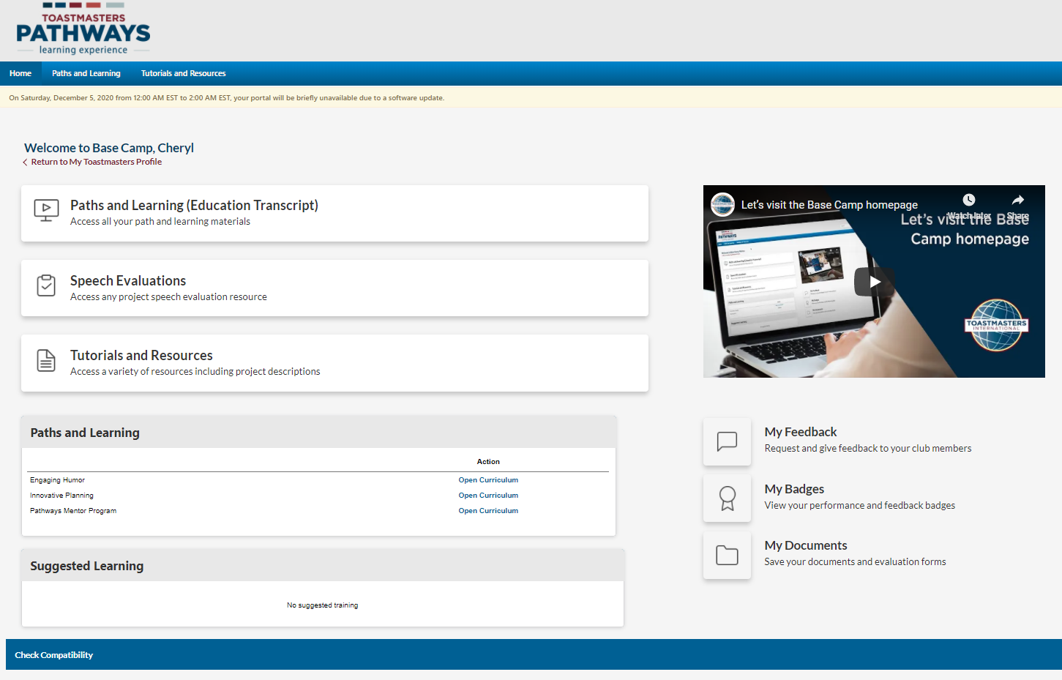
Access Your Content from Home Page
Notes:
1. One can also access the Feedback, Badges, and Documents areas from the Base Camp home page.

Slide 14
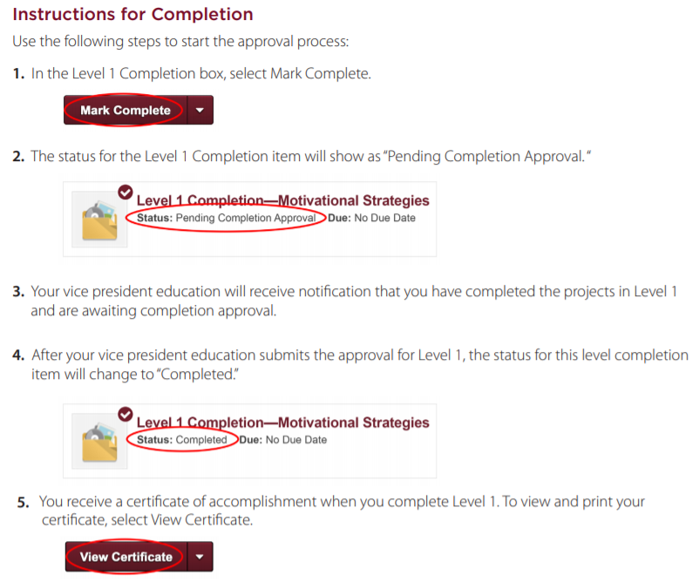
Complete a Level
Notes:
One should ensure that their VPE submits the level completion in Club Central also.
As a reminder, the minimum # of items required must be satisfied before being able to mark a level complete.
One can do speeches out of order; however, level approvals must be submitted sequentially.
The entire path will be marked completed after the final “Path Completion” speech has been completed.

Slide 15
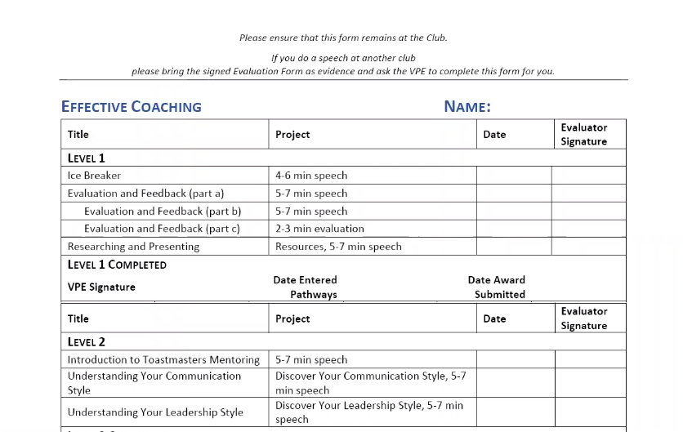
Sample Document for Tracking Progress
Notes:
1. There are tracking progress documents available for those to record the completion of their speeches. They can be found on the District website on Monday.

Slide 16
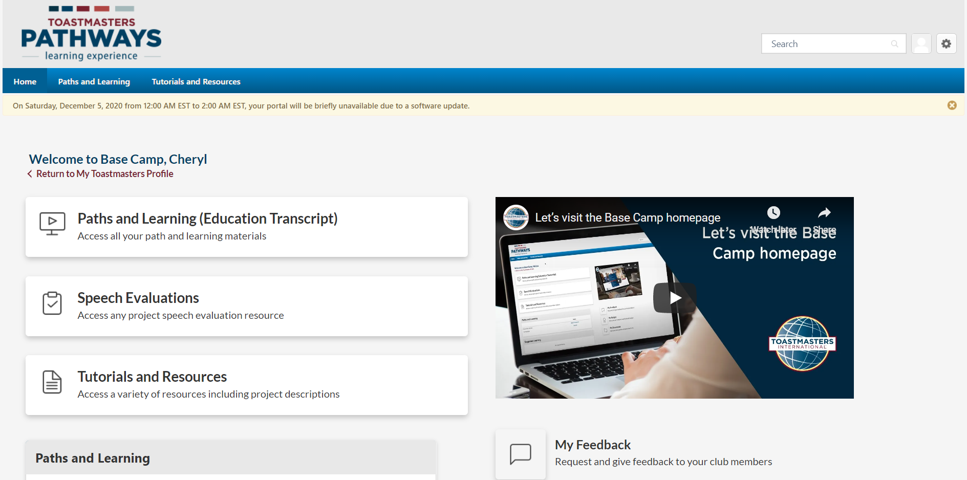
Access Speech Evaluations
One can go here to search for and download any speech evaluation form that he/she may need.
Notes:
1. Club members can use this area to search for and download fillable PDF versions of the speech evaluation forms, if needed. You must download the form to your computer in order to retain the “filled in” information. It is suggested to open the blank form, then “save as” the file with the speaker’s name and date of speech, then fill in the details on the form.

Slide 17
Access Tutorials and Resources
One can access how-to tutorial videos here.
Notes:
Resources for every project in any Path.

Slide 18
Return to Toastmasters Website

Slide 19
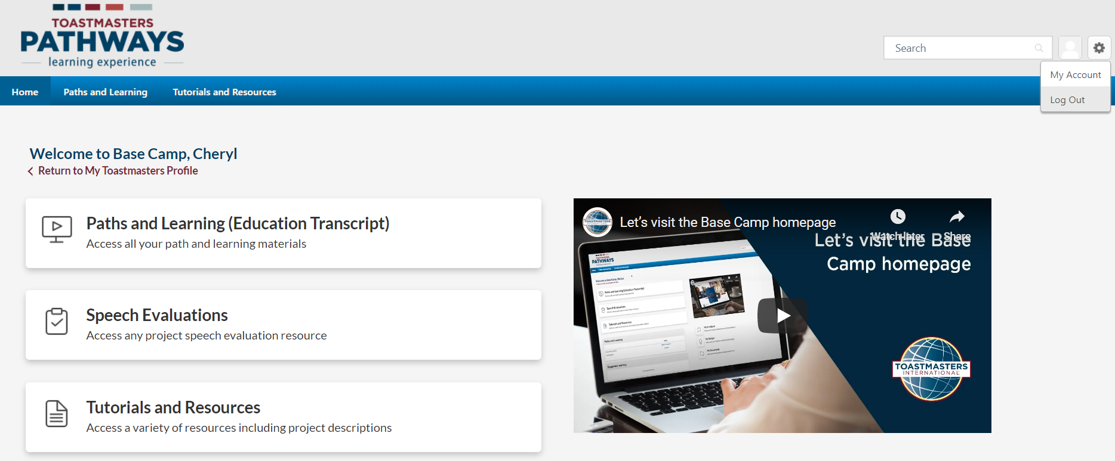
Log Out of Base Camp
Notes:
This option is for logging out of Base Camp. One must also log out of the Toastmasters main site as well in order to log out of Toastmasters completely.
Selecting this log out option will return the user to the Toastmasters.org website.

Slide 20
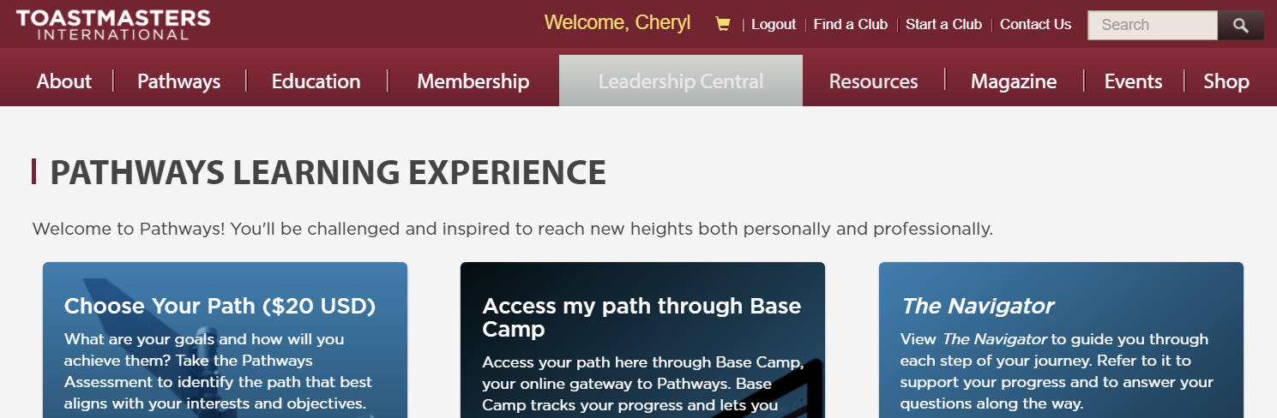
Log Out of Toastmasters

Slide 21
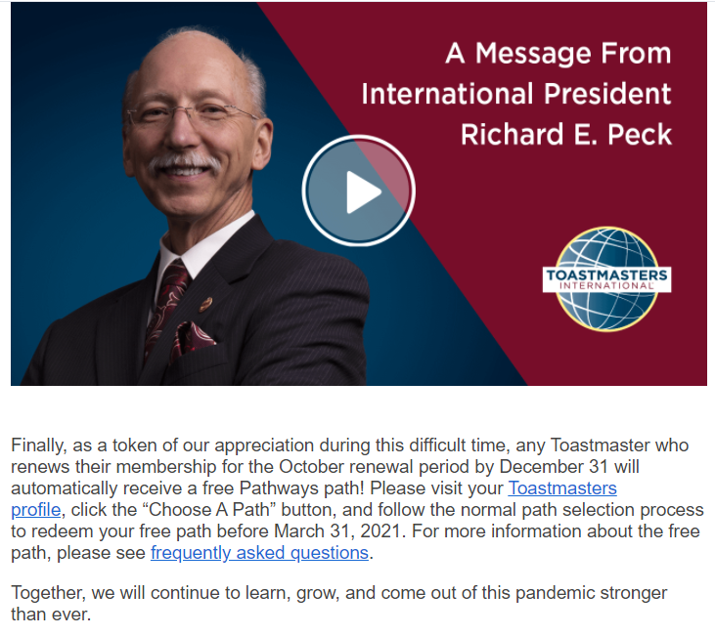
Free Path Incentive
Notes:
The free path ($20 value) is only available for members that have renewed their membership during the Oct 2020-Mar 2021 membership cycle. New and reinstated members are not applicable to receive the free path.
Even if members are not ready to start a second path, they should add it to their curriculum and start any time. The path must be selected by March 31, 2021.
To view the FAQs page regarding the free path, click the slide’s title above.

Slide 22
Additional Pathways Resources
Online tutorial videos
Email questions to the Pathways Champions
D44 website
Notes:
In case the first link above doesn’t work, note that additional online tutorial videos can be accessed via Base Camp. Once logged in, just navigate to the Tutorials and Resources section.

Slide 23
Questions?

