Slide 1

Pathways Potpourri
Things that don’t fit anywhere else or deserve to be specifically highlighted.

Slide 2
Table of Contents
Submit an External Training Request
Pathways Accessible Materials Information
Project Evaluation of your Completed Level
Multiple Clubs or Multiple Paths
Progress Sheets
Progress Tracking Spreadsheet

Slide 3
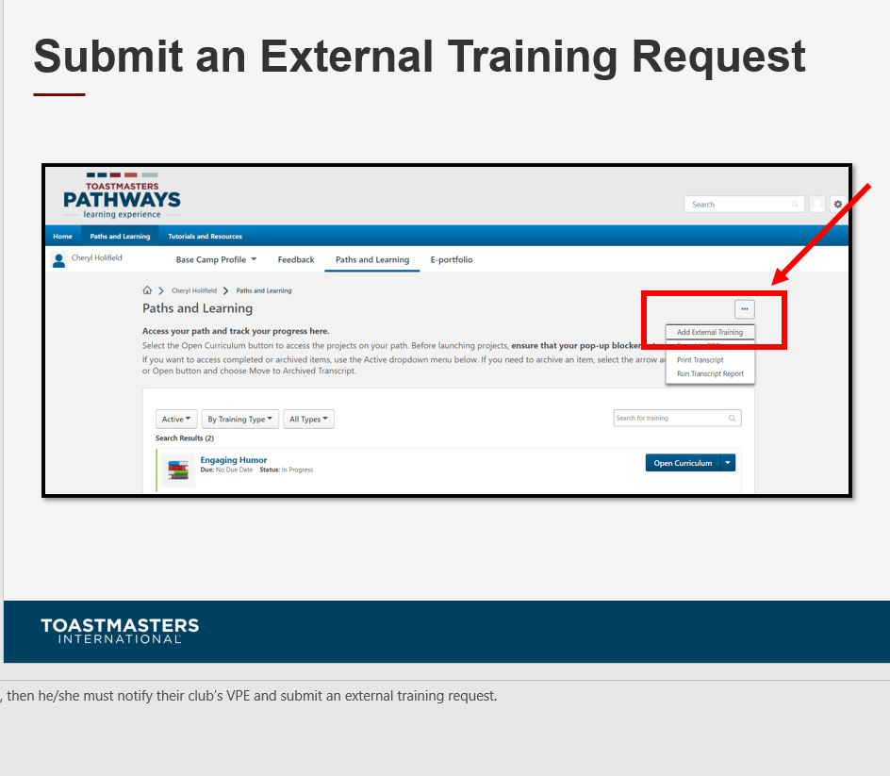

Slide 4
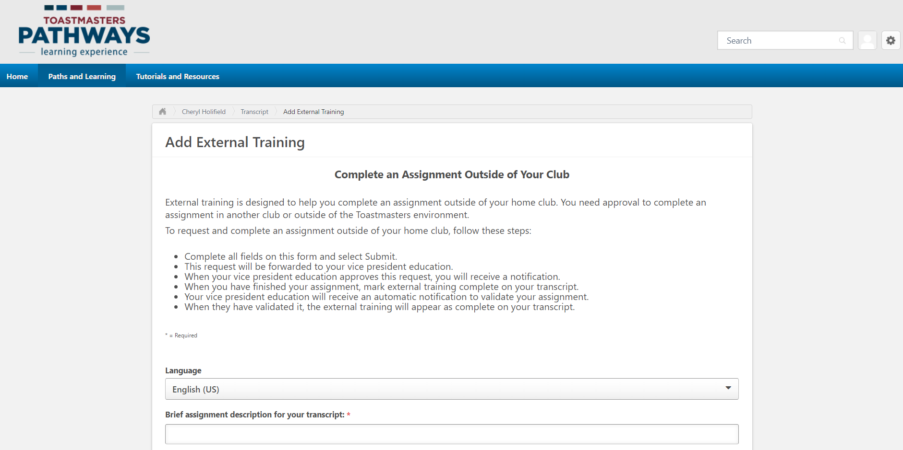
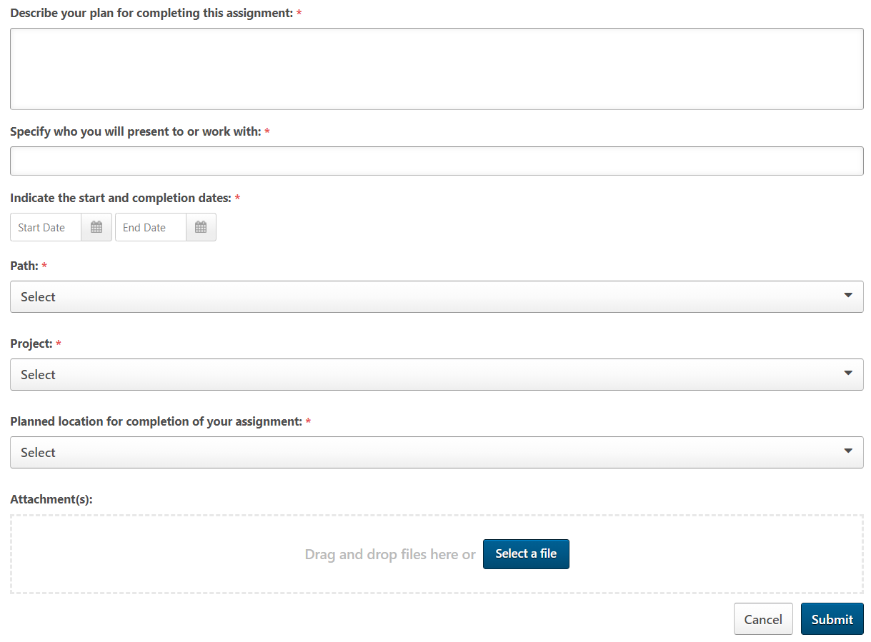
Complete External Training Request Form
Notes:
Once the request has been submitted, a task will be created for the VPE or Base Camp Manager to approve/deny.

Slide 5
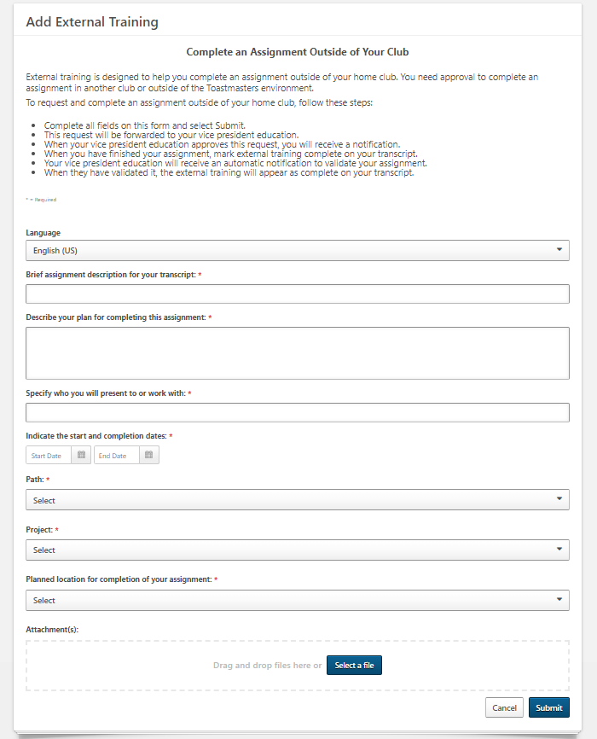

Slide 6
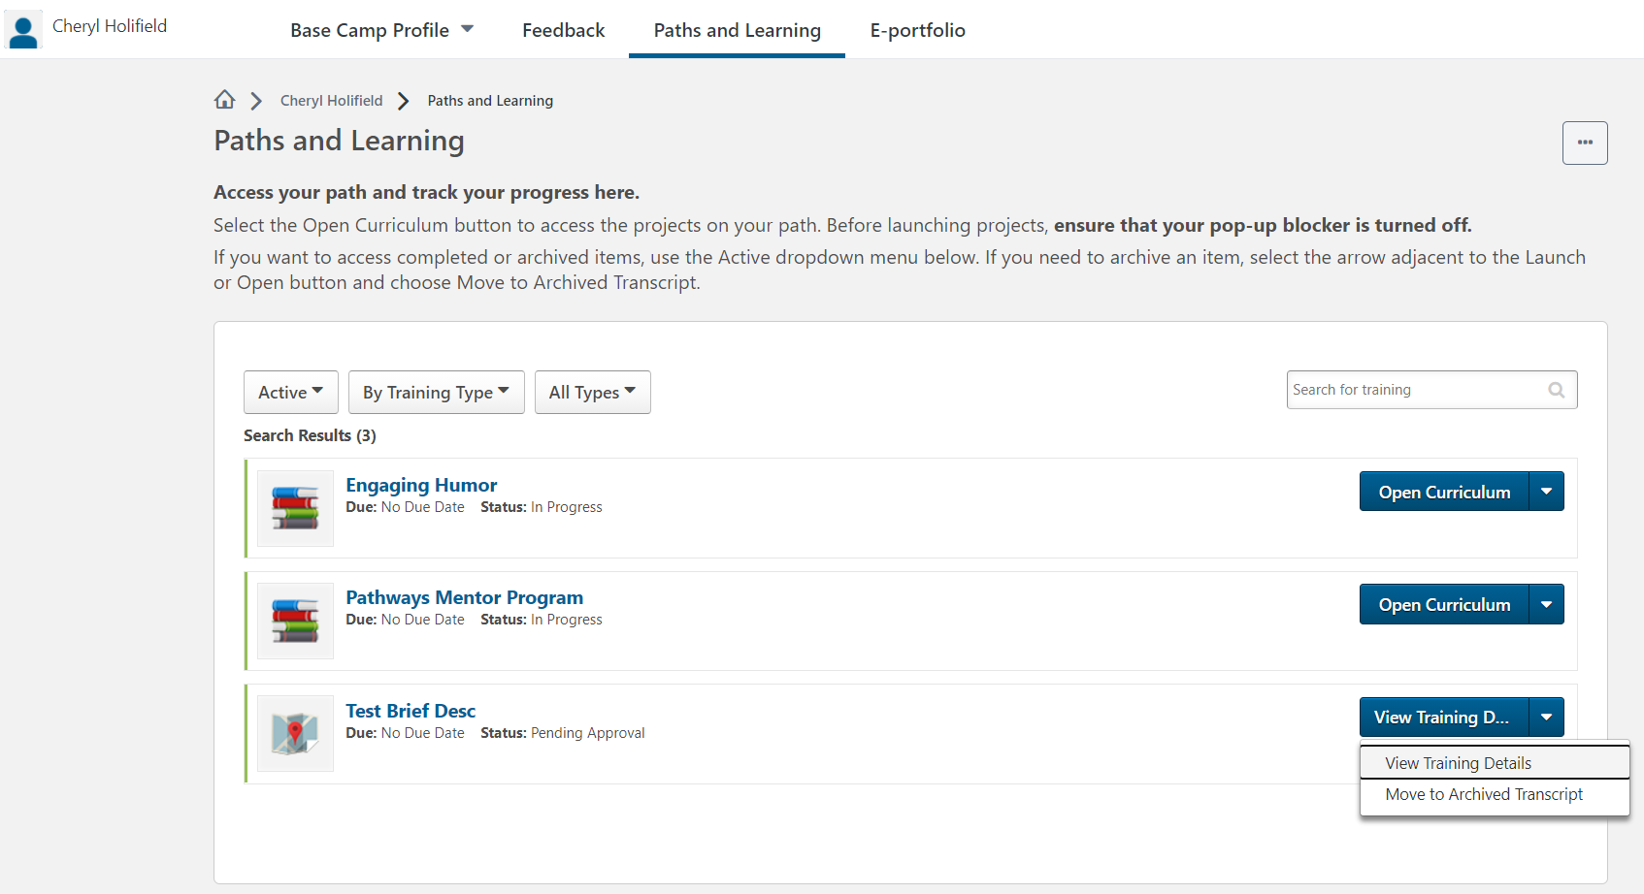
External Request is Displayed
The external training request added.
Select to view the details of the training request.

Slide 7
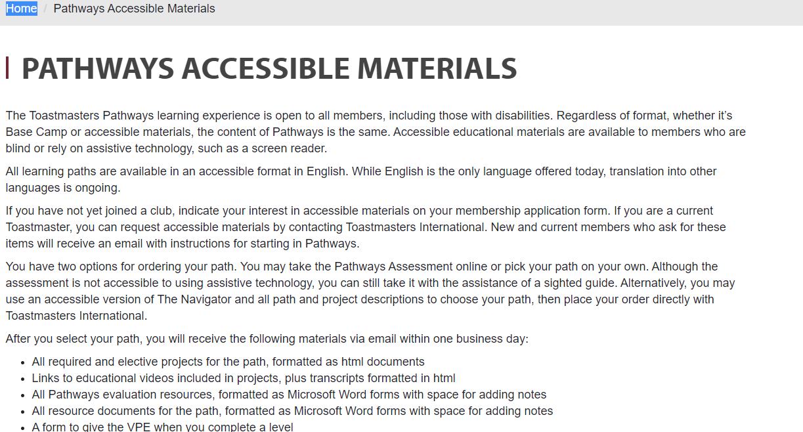

Slide 8
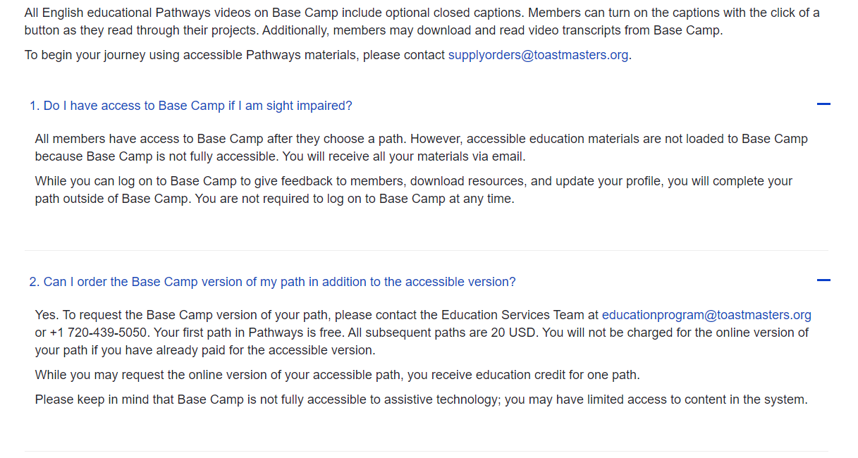

Slide 9
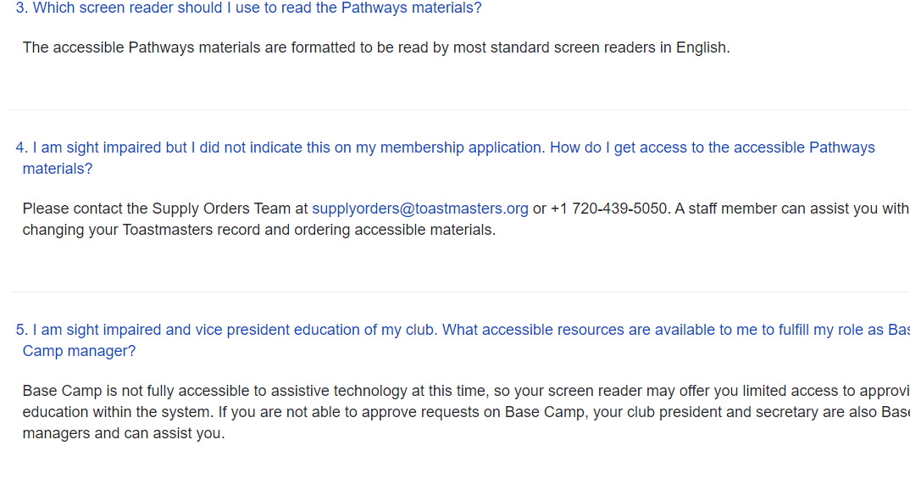

Slide 10
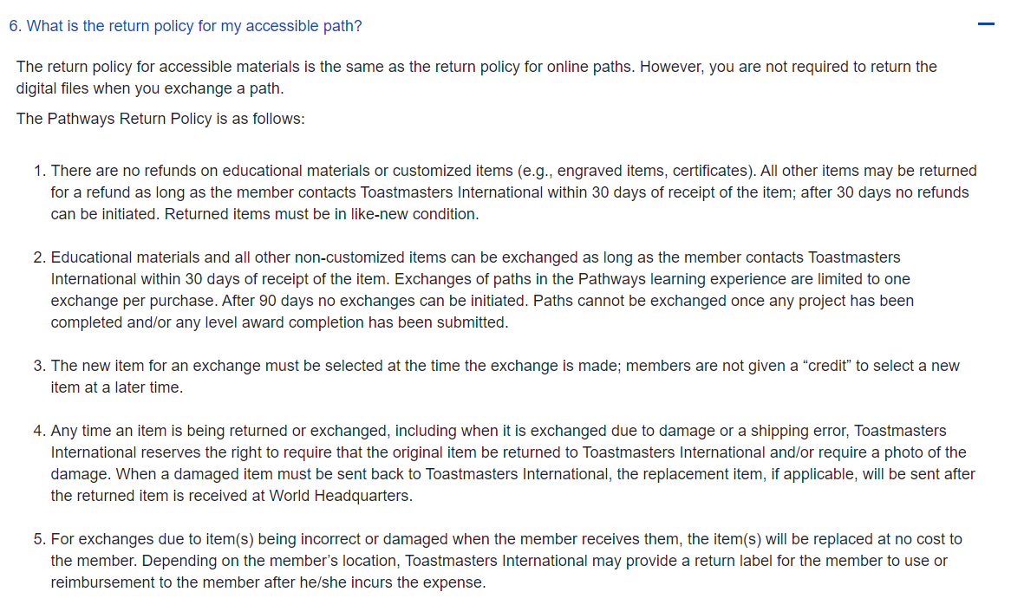

Slide 11
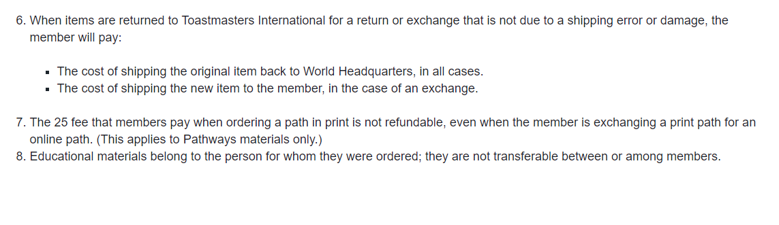

Slide 12
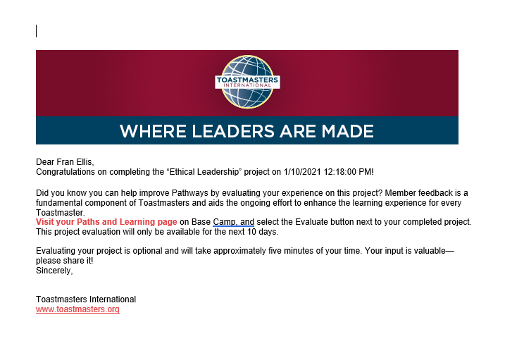
You Completed Your Project -- Evaluate it!
From BaseCamp@toastmasters.org

Slide 13
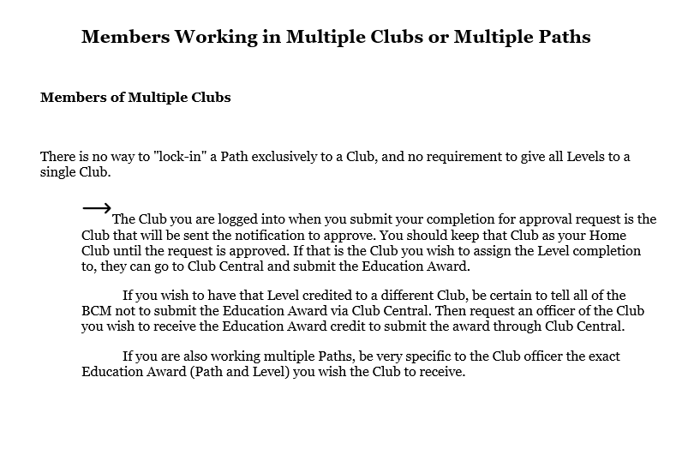

Slide 14
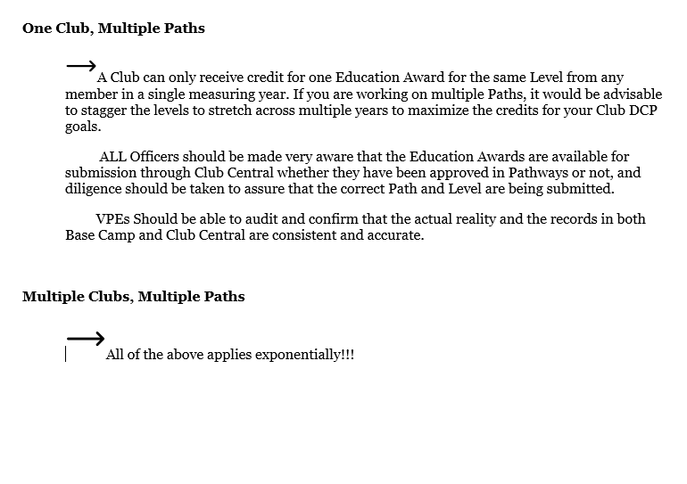

Slide 15
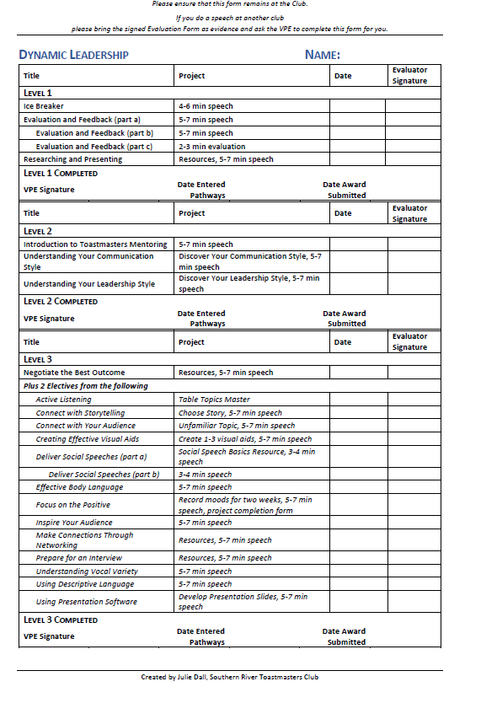
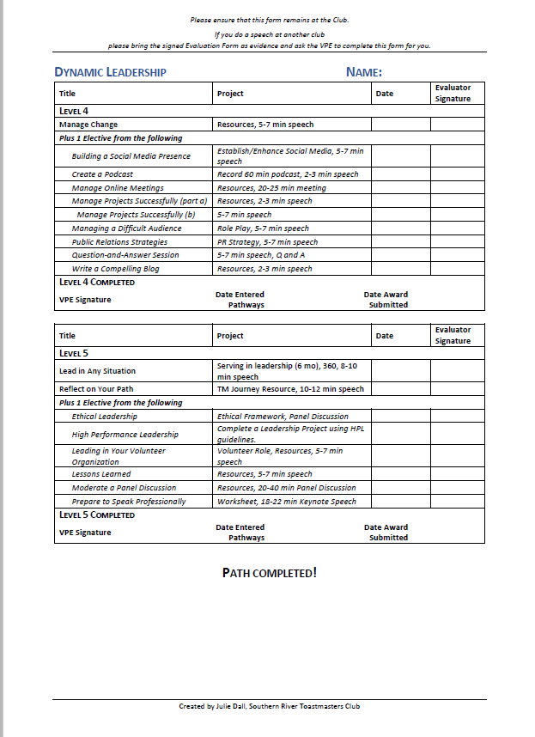
Progress Tracking Sheets for use by Members or VPEs

Slide 16
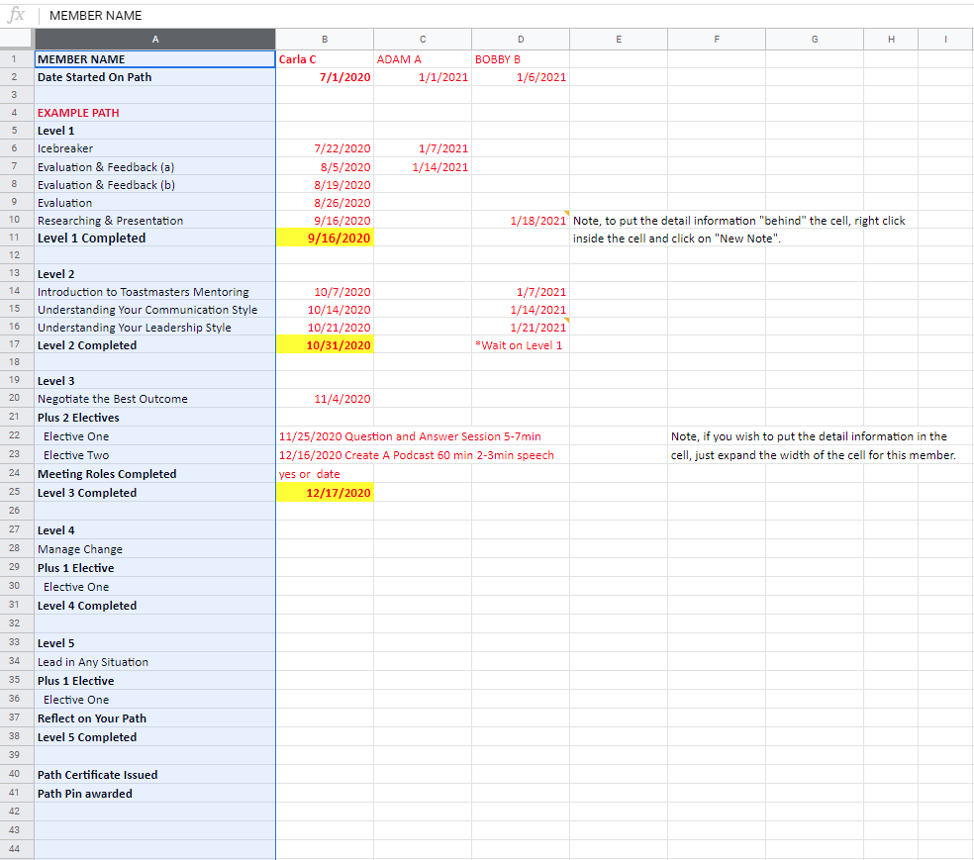

Slide 17
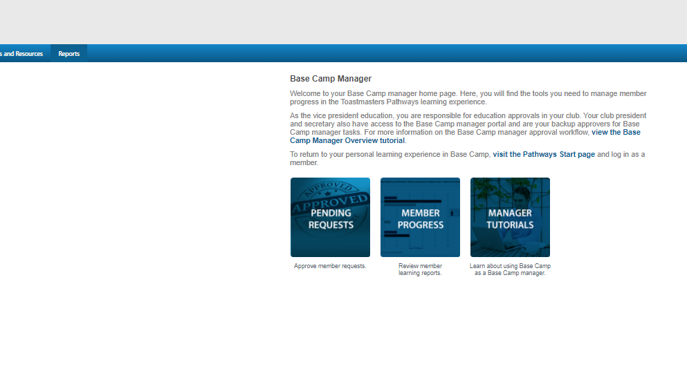

Slide 18
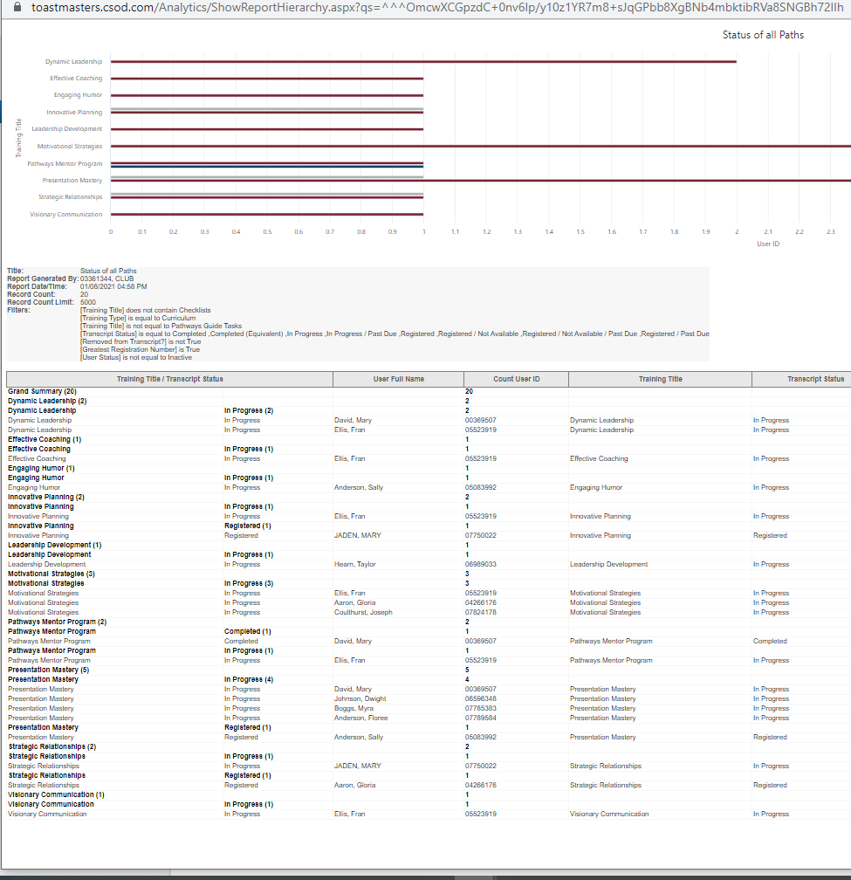

Slide 19
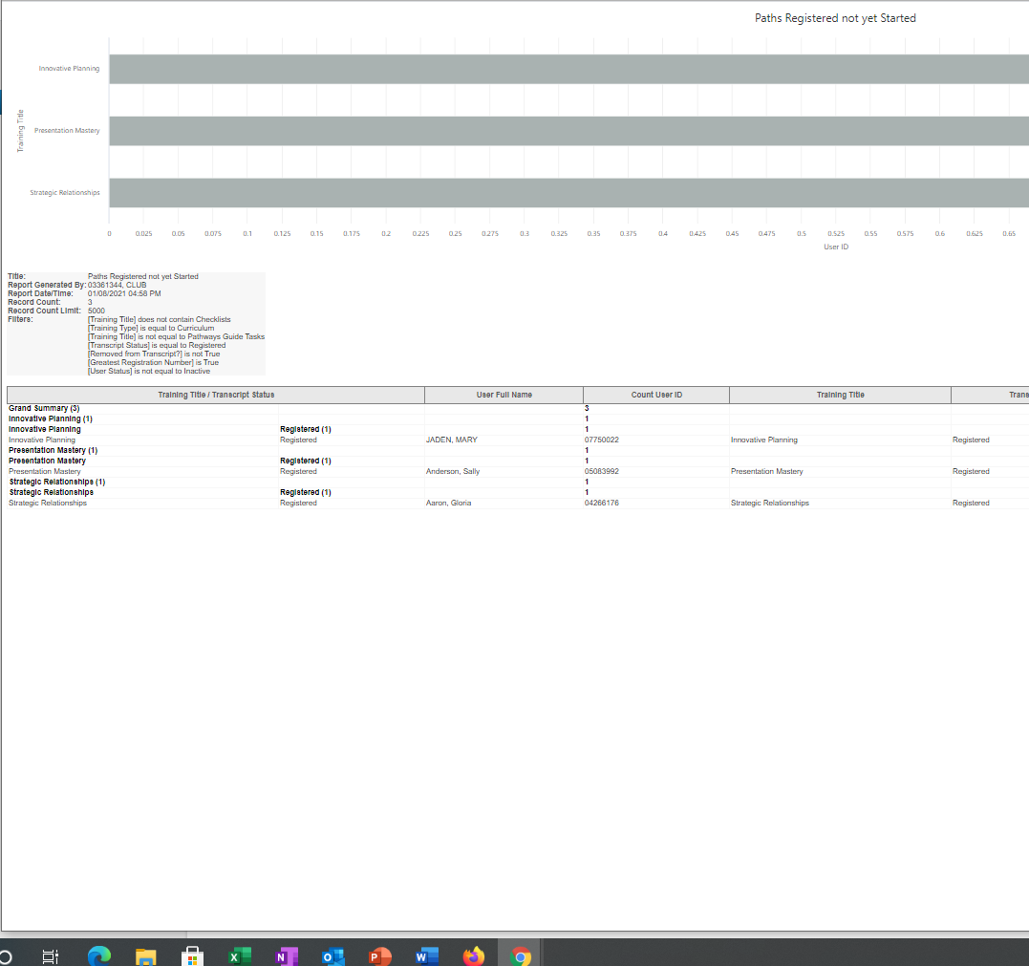

Slide 20
Questions?

